Slide 1
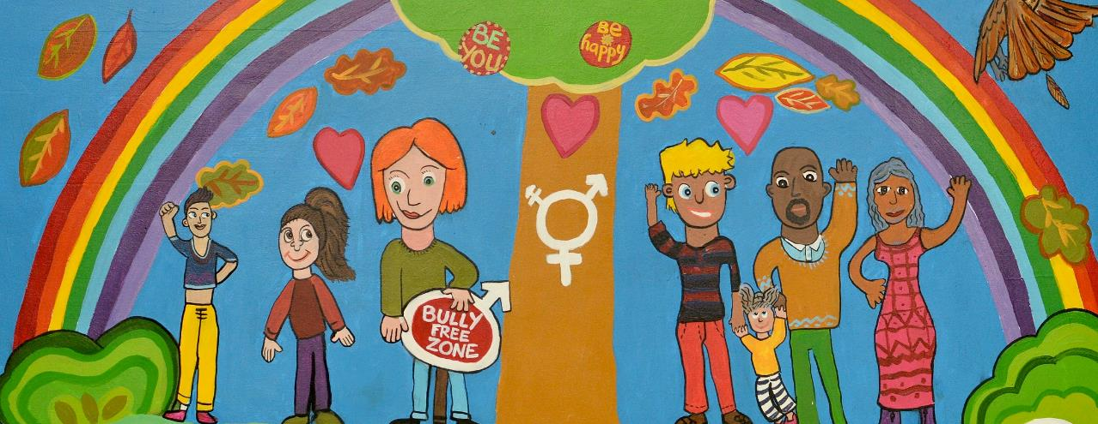
The UNCRC in Scotland – what does it mean for families?
Juliet Harris, Director, Together (Scottish Alliance for Children’s Rights)
Thursday 16th September 2021

Slide 2


Together
(Scottish Alliance for Children’s Rights)
An NGO alliance with over 480 members working to improve the awareness, understanding and implementation of children’s human rights in Scotland.
Vision:
All children and young people growing up in Scotland have their human rights respected, protected and fulfilled.
Mission:
We work to inspire and enable everyone in Scotland to put children and young people’s human rights at the heart of everything they do.

Slide 3

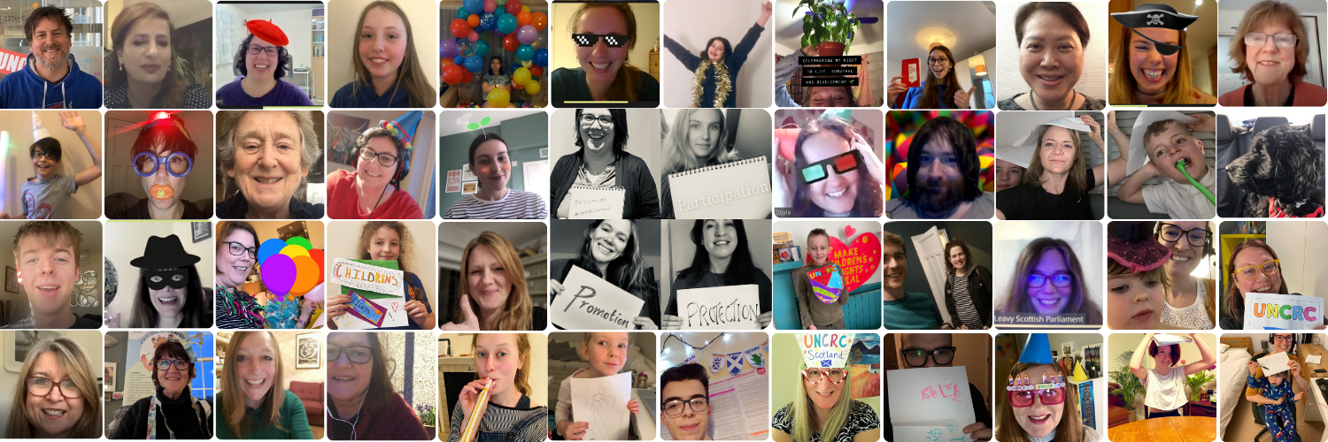
6 months ago – celebrating UNCRC incorporation
“…..the full range of children’s rights within the powers of the Parliament will be woven into the fabric of our law, our policy and our public life in Scotland”
Maree Todd MSP
Minister for Children and Young People

Slide 4
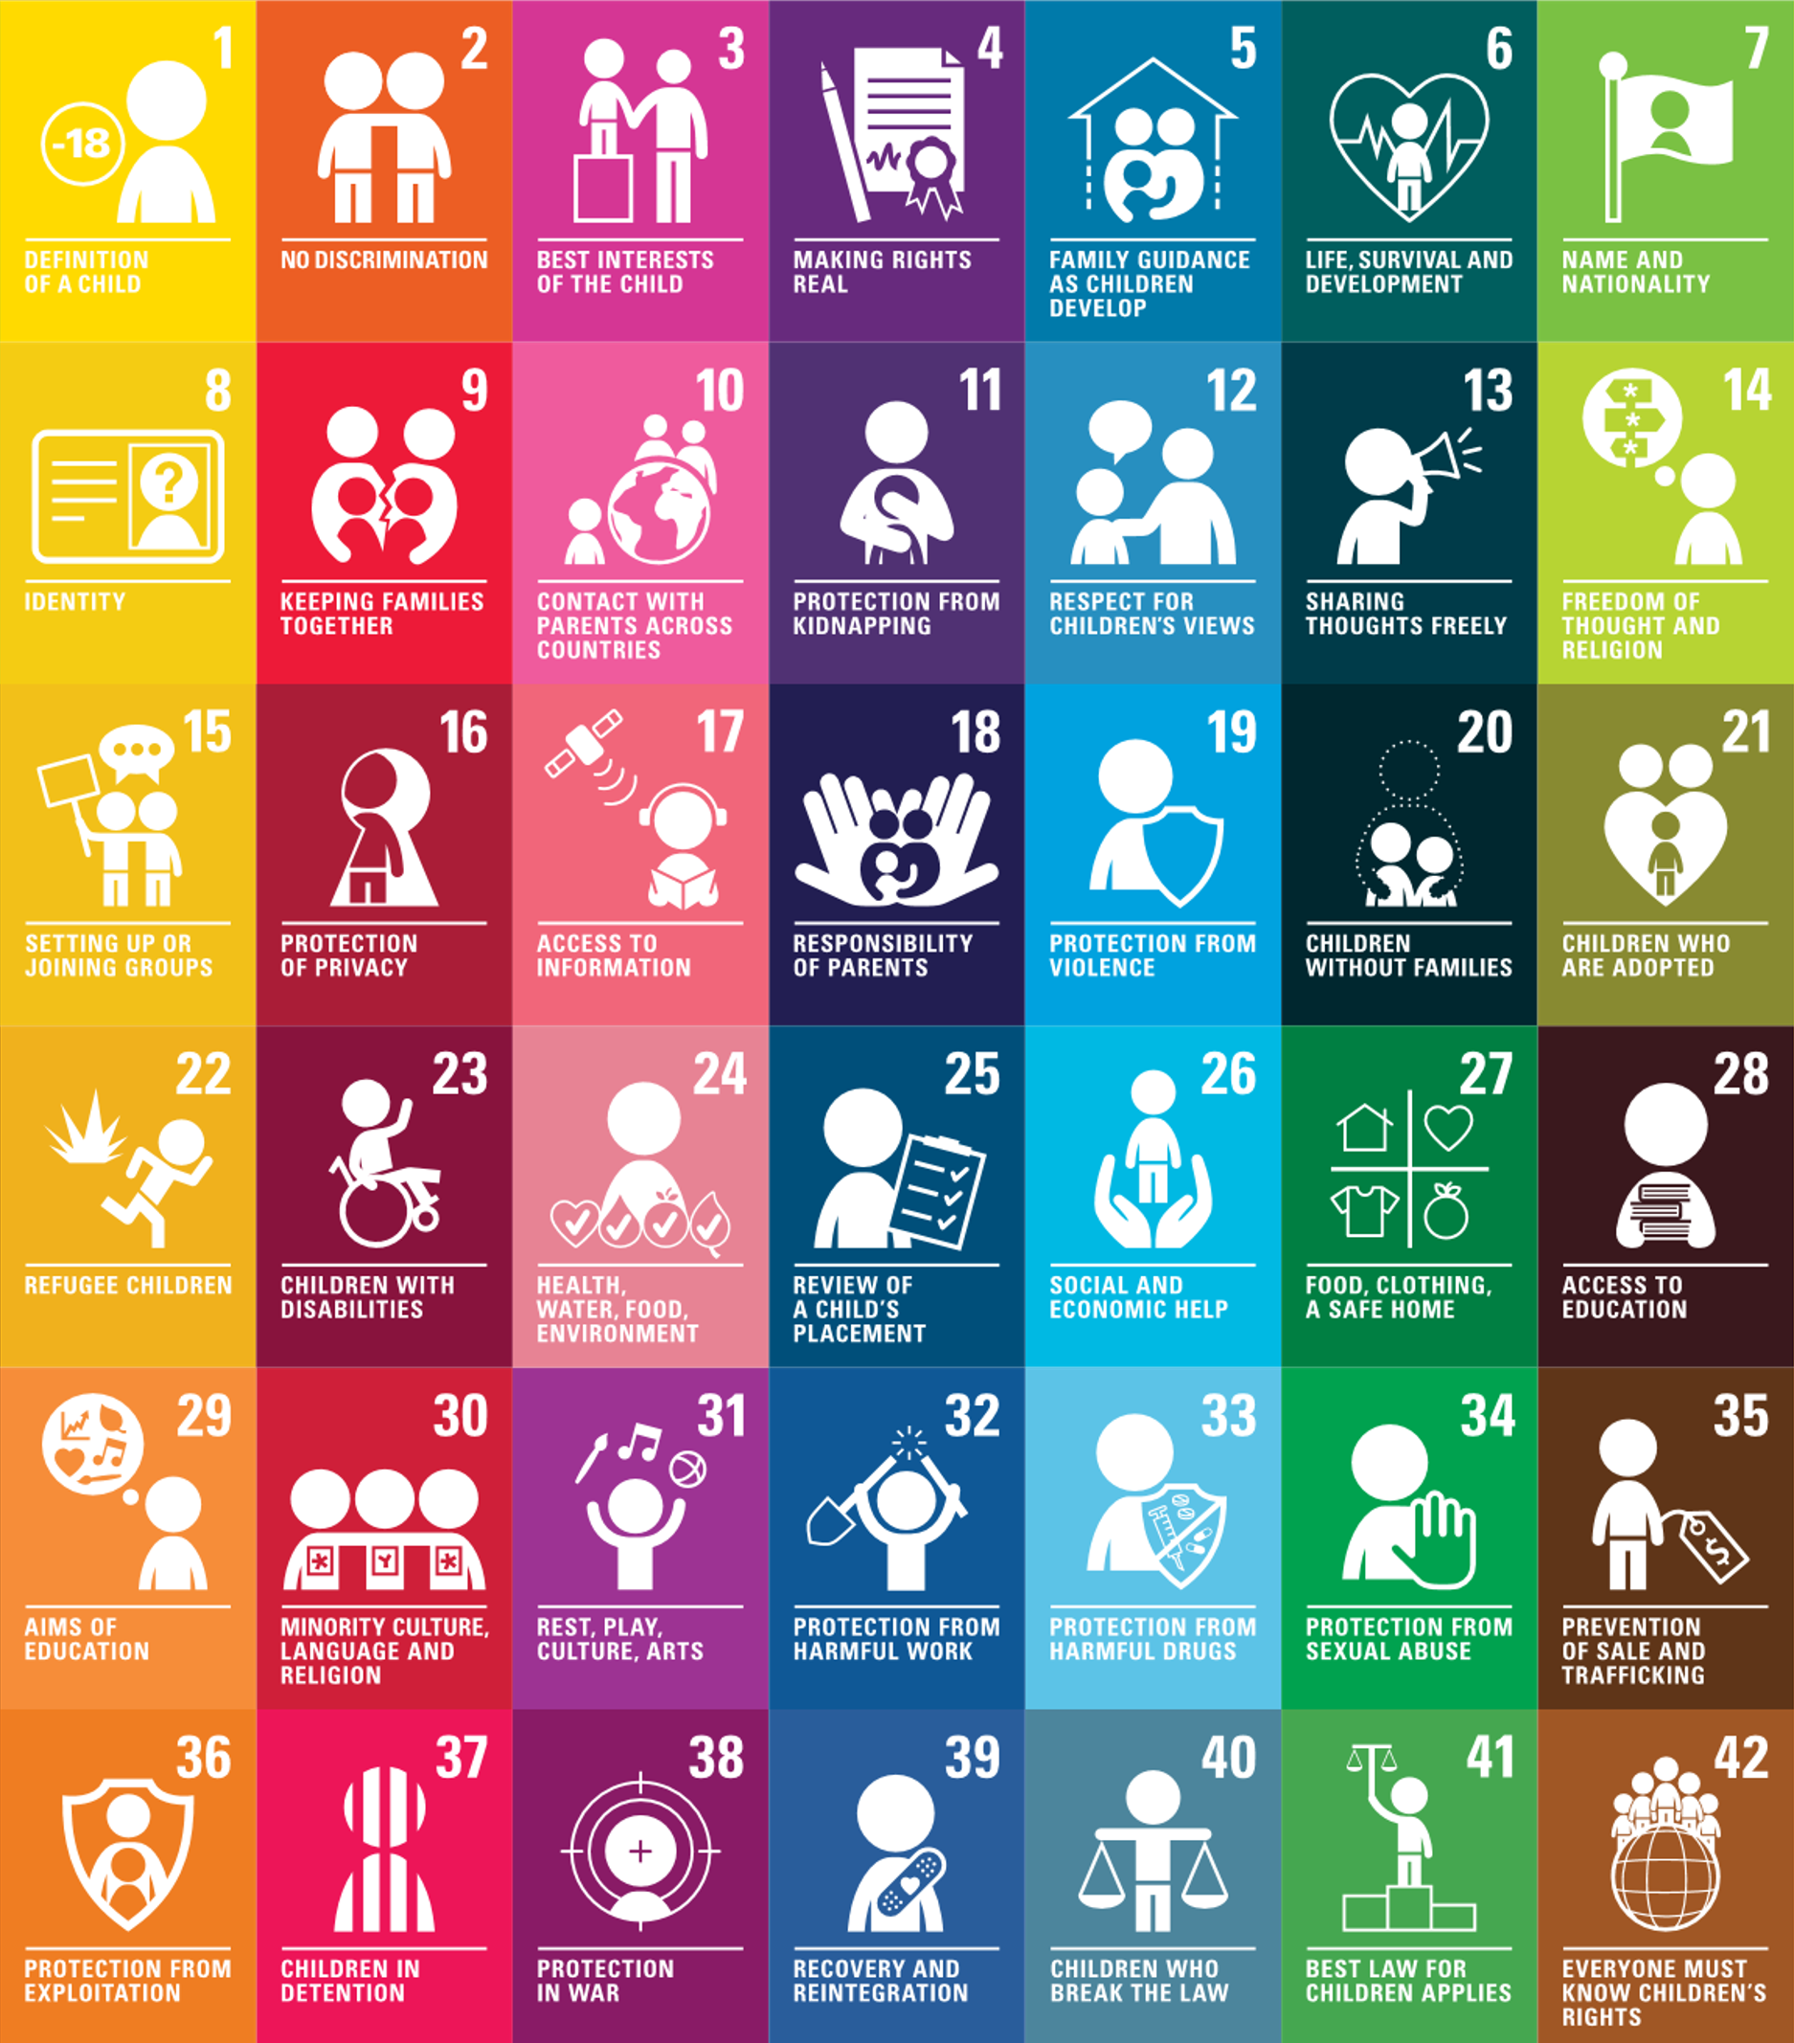
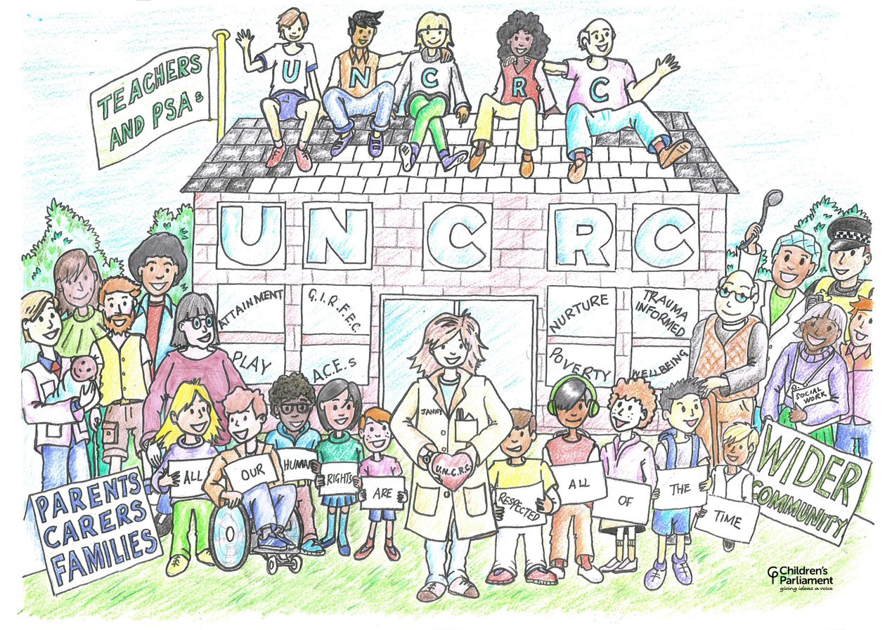
The UNCRC - covering every aspect of children’s lives

Slide 5
The UNCRC’s 42 substantive rights for children
Universal – rights are for ALL children, regardless of race, religion, abilities or family circumstances
Unconditional - all children are entitled to rights
Inalienable – rights cannot be given or taken away
Inherent – rights are permanent
Indivisible - rights are completely interdependent and depend on each other for their effectiveness
Do luchd-ionnsachaidh na h-Alba, le luchd-foghlaim Alba
Notes:
Human rights are Universal:
The UNCRC applies to ALL children, regardless of race, religion, abilities or family circumstances
.
Rights are Unconditional
All children everywhere in the world are entitled to rights – they do not have to be earned
They are not dependant on responsibilities – children have them regardless
Human rights are Inalienable
Thy cannot be given or taken away
Inherent
They are permanent and cannot be separated from the individual
Human rights are Indivisible:
Rights are completely interdependent and depend on each other for their effectiveness. So for example children have the right to relax and play and they also have the right of free assembly. They need to exercise both these rights for either one to work properly
Description taken from the Save the Children material produced for ‘Children’s Rights Wales’
(http://www.childrensrightswales.org.uk/userfiles/file/Teachers_new.ppt)

Slide 6
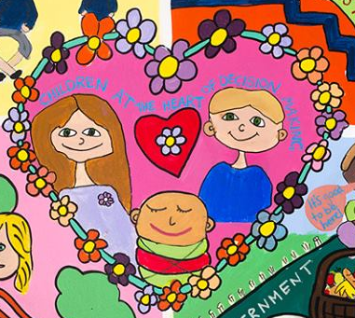
Families and the UNCRC
“the family, as the fundamental group in society and the natural environment for the growth and well-being of all its members and particularly children, should be afforded the necessary protection and assistance so that it can fully assume its responsibilities within the community”.
UNCRC preamble
Parents and carers directly referenced in articles 5, 18 and 27
References to parenting and the role of families are made throughout in no less than 23 of the 42 articles!
Notes:
The UNCRC defines the context in which parenting takes place. It promotes parenting that is respectful of the child’s best interests and considerate of the needs of parents.
It states that the child is entitled to care, security and an upbringing that is respectful of their rights and individuality.
The UNCRC outlines the role of the parent in guaranteeing and promoting the rights of the child and ensuring that their best interests are always taken into account. It outlines how parents should fulfil their responsibilities and is clear that the state should provide parents with the necessary level of support they need to fulfil their role.

Slide 7

Particularly relevant rights
Article 5 makes clear the government’s responsibility to respect the rights and responsibilities of parents to guide and advise their child so that as the children grow, they are able to apply their rights properly.
Article 18 makes clear that governments must recognise parental responsibilities and provide resources and support to help them fulfil their responsibilities.
Article 27 makes clear that government should assist parents and carers to ensure children are provided with an adequate standard of living.

Slide 8
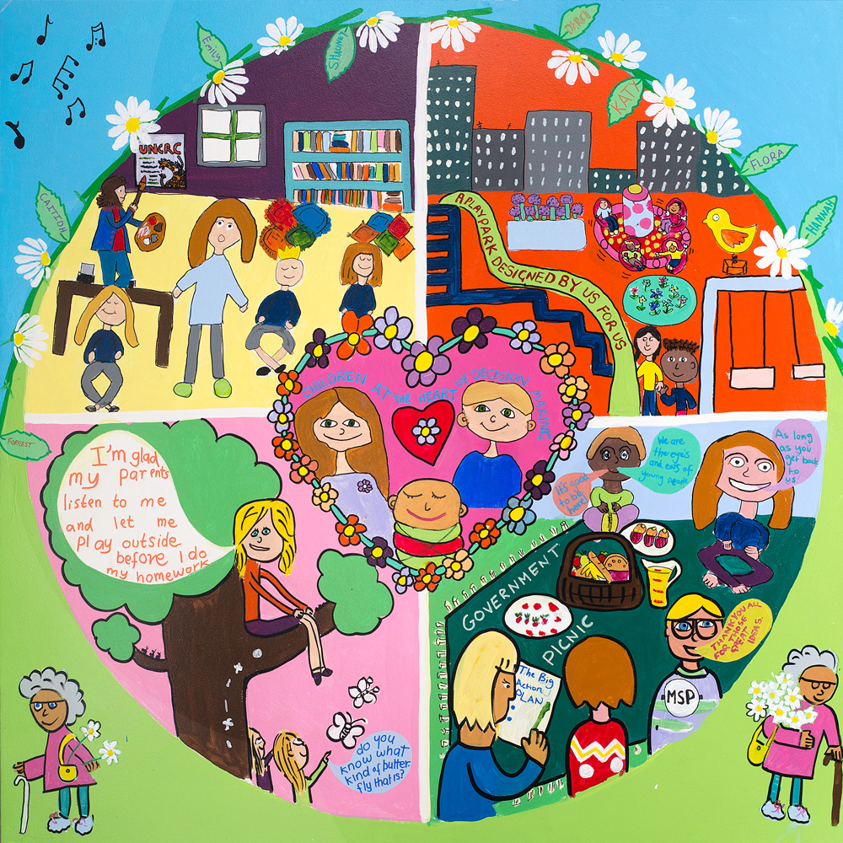
What is incorporation?
“Incorporation should mean that the provisions of the Convention can be directly invoked before the courts and applied by national authorities and that the Convention will prevail where there is a conflict with domestic legislation or common practice.”
UN Committee on the Rights of the Child
General Comment No. 5
Bringing international human rights into domestic law to ensure:
Rights are binding rather than guiding and can be enforced through the courts.
All levels of government apply the rights in legislation, policy and practice.
Rights provide an overarching legal framework through which all other decisions are made.
UN Committee on the Rights of the Child, General Comment No. 5: https://tbinternet.ohchr.org/_layouts/15/treatybodyexternal/Download.aspx?symbolno=CRC%2fGC%2f2003%2f5&Lang=en

Slide 9
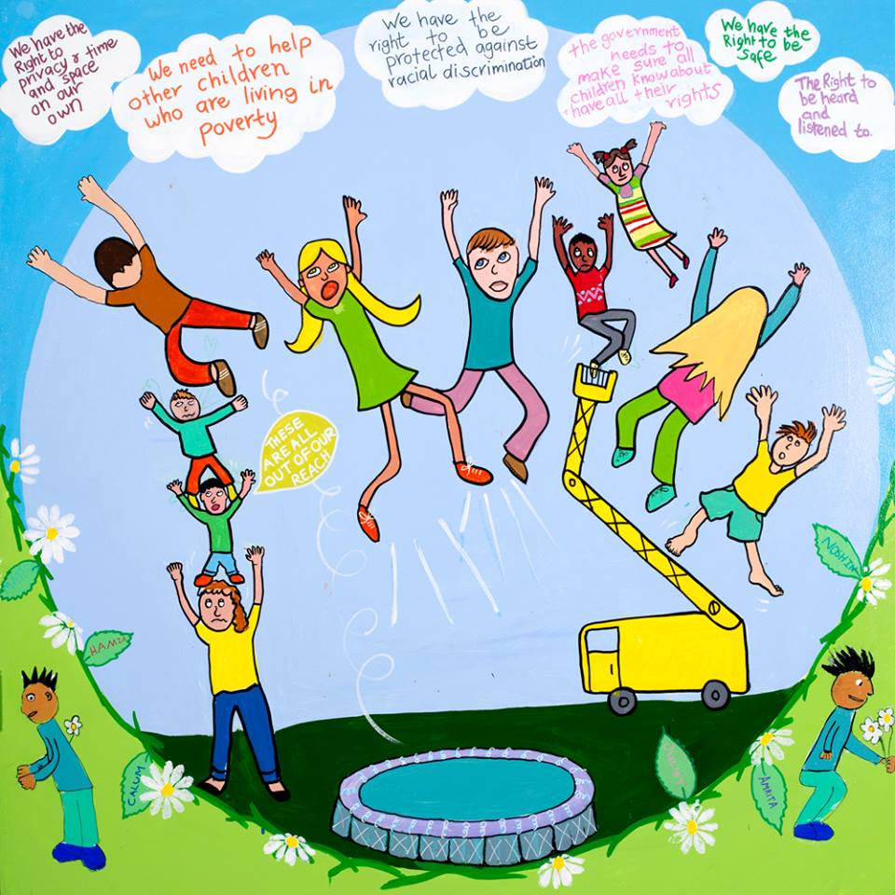
Incorporation:
Bringing rights within reach!
UN Convention on the Rights of the Child (Incorporation) (Scotland) Bill to be passed before the 2021 Scottish Parliament election.
Providing a legacy from the Year of Young People (2018) and celebrating the 30th Anniversary of the UNCRC (2019).
A solid foundation – with nearly 30 years of experience of reflecting the UNCRC in law, policy and practice.

Slide 10
Why is UNCRC incorporation important?
“What’s the point [in having rights] if they don’t have to abide by them?"
“Enforce children’s rights instead of letting it be optional to people”.
“Rights should be part of the culture of life”.
"If it's not the law then people might not give me my rights".
Delivering for Today,
Investing for Tomorrow
The government’s programme
for Scotland 2018-19
Children’s Parliament Response to the Rights of Children & Young People Bill – 2013
https://www2.gov.scot/Resource/0038/00386681.pdf
Notes:
UK ratified UNCRC on 16 December 1991
Children’s Parliament members were 9-13 years old in 2011. They’re now 16-20 years old in 2018.
“Rights without remedies are of symbolic importance, no more” Professor Michael Freeman (2010)

Slide 11
Scotland’s incremental approach to UNCRC incorporation
CYP Act passed by the Scottish Parliament on 19th February 2014
CRWIA in use by Scottish Government officials from 15th June 2015
UN Committee’s Concluding Observations to the UK published
Public bodies under duty to report every 3 years on steps taken to further UNCRC
Ministers publish UNCRC progress report & Action Plan
Public bodies to public first children’s rights reports
Public bodies to public first children’s rights reports
Bill unanimously passed by the Scottish Parliament to incorporate UNCRC
2014
2015
2016
2017
2018
2020
2021
2019
Ongoing duty on Ministers to raise awareness and understanding of UNCRC

Slide 12


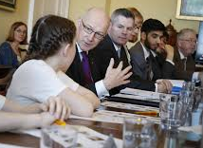
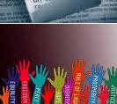


UNCRC incorporation in Scotland
Children and young people’s journey…
The UN General Assembly adopts the UN Convention on the Rights of the Child
Children and young people call for UNCRC incorporation through the Children and Young People (Scotland) Bill
Scottish Youth Parliament manifesto found that 76% of young people supported UNCRC incorporation
Scottish Youth Parliament launches ‘Right Here, Right Now” to campaign for incorporation
Children and young people call for incorporation in the annual meeting with Cabinet
Children and young people support the UNCRC Bill through Parliament!
2013-14
2016
2017-18
2017-19
1989
2020-21

Slide 13




UNCRC (Incorporation) (Scotland) Bill
A proactive culture (the carrot!)
UNCRC and Optional Protocols
The UNCRC (the minimum core (or floor!) of rights for every child.
Challenging breaches (the reactive stick!)

Slide 14
UNCRC (Incorporation) (Scotland) Bill
A pro-active approach
Protects the UNCRC rights of all children under 18 years old (s.1).
Public authorities must act compatibly with UNCRC (s.6).
Children’s Scheme: participation, awareness, budgeting and child rights impact assessments (s.11-13).
Duty on Ministers to conduct Child Rights & Wellbeing Impact Assessment (s.14).
Compliance reports by Ministers and public authorities (s.15-16).
Scrutiny by children, young people, Children and Young People’s Commissioner, Scottish Parliament, civil society.
Challenging breaches
Children and young people can complain if they think their rights aren’t being protected (s.7).
Courts can decide if laws follow the UNCRC (s. 18-21).
The Children and Young People’s Commissioner will be able to help if someone wants to complain their rights are not being protected (s.10).
A court could tell an organisation to change what they are doing, if the court agrees that they are not protecting children’s rights properly (s. 18-21).
No time limits on proceedings until children reach the age of 18 years old (s.7).
UNCRC (Incorporation) (Scotland) Bill: https://www.parliament.scot/-/media/files/legislation/bills/current-bills/united-nations-convention-on-the-rights-of-the-child-incorporation-scotland-bill/stage-3/bill-as-passed.pdf

Slide 15
My questions….
How can we best support and empower families to use the UNCRC to support the rights of children?
How can we ensure the UNCRC is embedded across universal services?
What else is needed to ensure UNCRC incorporation delivers the ‘revolution in children’s rights’ so heralded by the Deputy First Minister?

Slide 16
The UNCRC in Scotland – what does it mean for families?
Thank you! ☺

