Slide 1
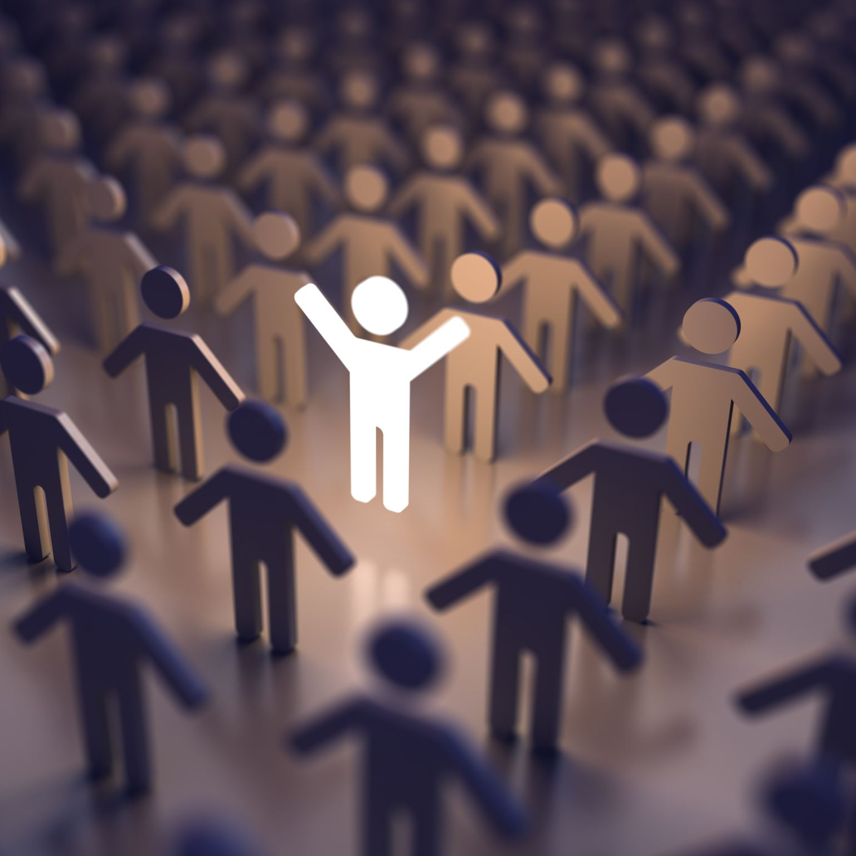
From rights to reality
b.m.featherstone@hud.ac.uk

Slide 2
Critical thinking and hope
‘It is important to say what hope is not; it is not the belief that everything was, is, or will be fine. The evidence is all around us of tremendous suffering and destruction. The hope I am interested in is about broad perspectives with specific possibilities, ones that invite or demand that we act. It is also not a sunny everything-is-getting-better narrative, though it may be a counter to the everything-is getting-worse one. You could call it an account of complexities and uncertainties with openings.
‘Critical thinking without hope is cynicism, but hope without critical thinking is naivety’ the Bulgarian writer, Maria Popova recently remarked’
(Rebecca Solnit, 2016: xi/ii).

Slide 3
Critical thinking
There are many concerns about the UNCRC as a manifestation of a Eurocentric model of childhood, and therefore part of attempts to impose this universally with no appreciation of context – eg, child labour
It is also important to note that countries around the world have had many complex, and not always edifying, reasons for ratifying the UNCRC

Slide 4
Discussions of children’s rights and perspectives sometimes imagine children exist separately from their social environments.
Yet many issues leading to contact with child protection services, for example, are related to wider struggles for justice (Keddel, 2021)

Slide 5
Part of the long march to justice?
To achieve a balanced assessment, I increasingly draw parallels with the struggle for women’s rights
From a liberal individualist approach to a understanding of relational autonomy
This notion combines a concern for the individual’s autonomy rights with an understanding of all family members as situated and engaged in relationships that are dynamic and multi-dimensional

Slide 6
Thinking about the current context
Covid-19 has exposed as well as intensified the inequalities in our current landscape

Slide 7
Who has died in this pandemic?
Far from the great leveller, mortality from COVID-19 follows the social gradient. COVID-19, of course, is caused by a virus. But the ‘causes of the causes’ are the same social conditions that give rise to the social gradient in health, more generally (Michael Marmot)…
Build Back Fairer: The COVID-19 Marmot Review | The Health Foundation

Slide 8
Everything is connected
‘Put differently, we estimate over 58,000 and 35,000 additional deaths from Covid-19 would have occurred if the white population had experienced the same risk of death from Covid-19 as the black and south Asian populations respectively’ (IPPR, 2020)
https://www.ippr.org/blog/ethnic-inequalities-in-covid-19-are-playing-out-again-how-can-we-stop-them

Slide 9

How have we been living?
We are not all in the same boat. We are all in the same storm. Some are on super-yachts. Some have just the one oar
Damian Barr (@Damian_Barr) April 21, 2020

Slide 10

Children, Young People and Covid
While children and young people have not been as vulnerable to illness and death, they have been disproportionately, and unequally, harmed by the impacts of restrictions and lockdown.
The closure of early years services, schools and youth facilities and disruption to universities, further education and apprenticeships have led to widening inequalities in children and young people’s development and education and in post-18 training and employment

Slide 11
This group is also experiencing rapid increases in unemployment and there has been a rise in mental health difficulties from a level that was already concerning.

Slide 12

Going forward
‘Build back fairer’
Attend to the ‘causes of the causes’
Develop a new social settlement – a new framework recognizing our interdependence, our need to care and be cared-for, participate in decisions affecting us, develop services together

Slide 13

What does this mean for children, young people and their families?
The notion of flourishing may help support a grounded interpretation of rights as exercised relationally and contextually
According to Aristotle, human flourishing, or eudaimonia, is a life in which one fulfils one’s potential as a human being.
As Hilary Cottam notes, flourishing is a collective and political concept that embraces participation in the structures of society – the household, the market, the community and the state

Slide 14
Young people re-imagining the welfare state
The Child Fair State Inquiry
https://www.childrenengland.org.uk/childfairstate
Led by young people this has a bold vision

Slide 15

The perils ahead
We focus solely on voice and participation as an end in itself
We ignore the need to ground rights in children’s lived realities
We see the child or children simply and reductively as individuals… a real danger in a climate of continuing funding challenges

Slide 16
An opportunity…
‘Historically, pandemics have forced humans to break with the past and imagine their world anew… a portal, a gateway between one world and the next. We can choose to walk through it, dragging the carcasses of our prejudice and hatred, our avarice, our data banks and dead ideas, our dead rivers and smoky skies behind us. Or we can walk through it lightly, with little luggage, ready to imagine another world. And ready to fight for it’ (Roy, 2020, p, 214)
Roy, A. (2020) Azadi, Penguin

Slide 17

Some references
Cottam H (2018) Radical Help, Virago
Featherstone, B et al (2021) Post-pandemic: moving on from ‘child protection’, Critical and Radical Social Work (contact b.m.featherstone@hud.ac.uk)
Marmot, M and Allen, J (2021) https://blogs.bmj.com/bmj/2021/06/30/michael-marmot-and-jessica-allen-building-back-fairer-in-greater-manchester/

