Slide 1
Children’s Rights
A ten-minute training tool
Start course

Slide 2
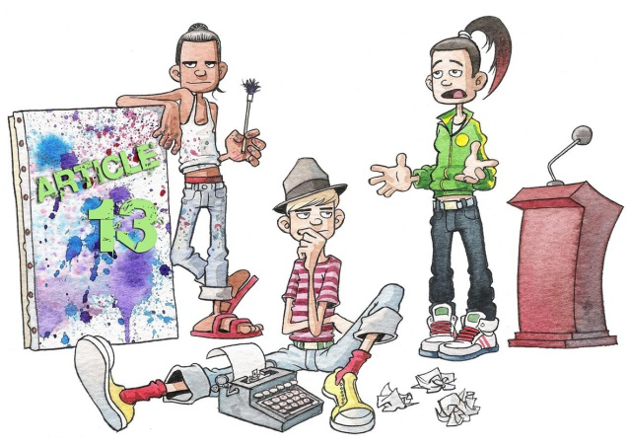
Introducing children’s rights
Course contents
Purpose
Introduction
Rights
What are human rights?
International human rights
European human rights
Human rights in Scotland
How does the UNCRC work?
Children’s rights and the Scottish Government
The Children and Young People (Scotland) Act 2014
What is the Child Rights and Wellbeing Impact Assessment (CRWIA)?
Why do we need CRWIAs?
Involving children and young people
Acknowledgements
Purpose of training
Gaining an understanding of children’s rights, rights frameworks (e.g. UNCRC) and rights-based legislation (e.g. the Children and Young People (Scotland) Act 2014).
A ‘prior knowledge prompt’ helps pre-empt the next topic, for those able to skip ahead.
Article 13: You should be able to express yourself freely, while respecting other people’s rights
‘Prior knowledge’ prompt
Which new Scottish legislation is children’s rights-based?
< Back
Next >

Slide 3
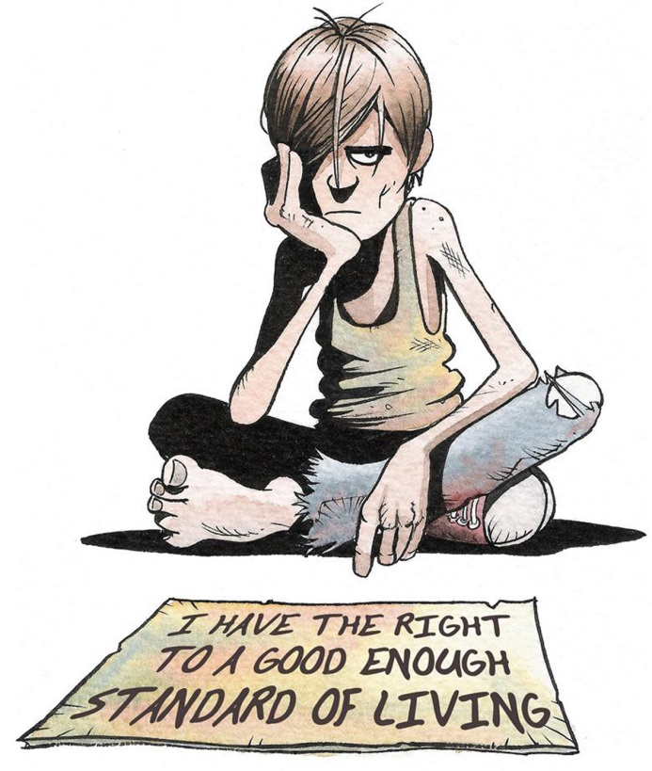
Introducing children’s rights
Course contents
Purpose
Introduction
Rights
What are human rights?
International human rights
European human rights
Human rights in Scotland
How does the UNCRC work?
Children’s rights and the Scottish Government
The Children and Young People (Scotland) Act 2014
What is the Child Rights and Wellbeing Impact Assessment (CRWIA)?
Why do we need CRWIAs?
Involving children and young people
Acknowledgements
Introduction
We want Scotland to be the best place in the world for a child to grow up, with opportunities for all in Scotland to flourish. An integral part of our vision is the recognition of, respect for and promotion of children’s human rights.
The UN Convention on the Rights of the Child (UNCRC) is the internationally mandated children’s rights framework that informs our strategies and programmes.
Part 1 of the Children and Young People (Scotland) Act 2014 embeds UNCRC rights in Scottish legislation and places new children’s rights duties on Scottish Ministers and public authorities.
Article 27
‘Prior knowledge’ prompt
What do ‘rights’ really mean?
< Back
Next >

Slide 4
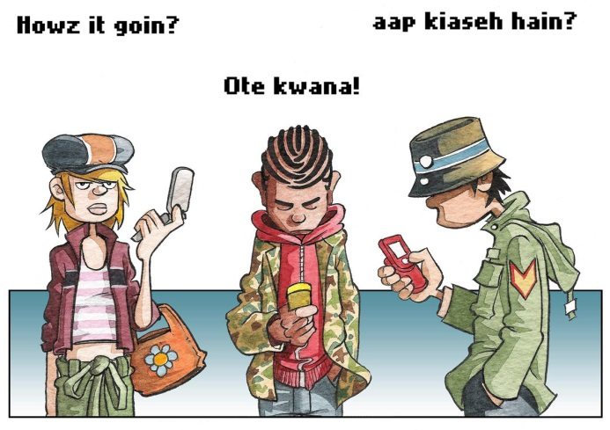
Introducing children’s rights
Course contents
Purpose
Introduction
Rights
What are human rights?
International human rights
European human rights
Human rights in Scotland
How does the UNCRC work?
Children’s rights and the Scottish Government
The Children and Young People (Scotland) Act 2014
What is the Child Rights and Wellbeing Impact Assessment (CRWIA)?
Why do we need CRWIAs?
Involving children and young people
Acknowledgements
What are ‘human rights’?
Human rights are the basic rights and freedoms to which we are all entitled in order to live with dignity, equality and fairness, and to develop and reach our potential. Human rights are:
universal
inalienable (not taken/given away)
indivisible
interdependent (loss of one impacts all).
Everyone, including children, has these rights, no matter what their circumstances. Under international law, States/Governments are obliged to respect, protect and fulfil human rights.
Article 30: You should be able to use your own language and enjoy the culture of your community in Scotland
‘Prior knowledge’ prompt
Which commitment on human rights became the foundation for international human rights law? Do any of the nine core international human rights instruments/treaties spring to mind?
< Back
Next >

Slide 5
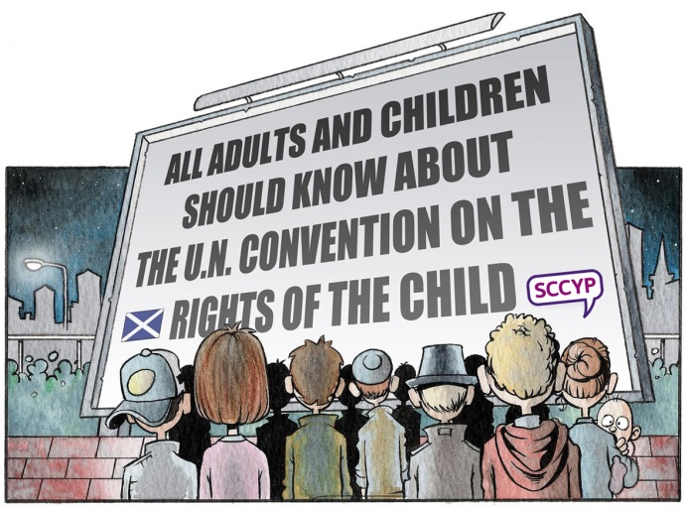
Introducing children’s rights
Course contents
Purpose
Introduction
Rights
What are human rights?
International human rights
European human rights
Human rights in Scotland
How does the UNCRC work?
Children’s rights and the Scottish Government
The Children and Young People (Scotland) Act 2014
What is the Child Rights and Wellbeing Impact Assessment (CRWIA)?
Why do we need CRWIAs?
Involving children and young people
Acknowledgements
International human rights instruments
The Universal Declaration of Human Rights is the foundation for international human rights law. It was adopted by the UN General Assembly in 1948 to provide common human rights standards for all peoples and nations in a post-war world.
From this arose nine core international human rights instruments or treaties, including the UN Convention on the Rights of the Child (UNCRC). The UNCRC duplicates some of the rights found in other international instruments. This is because the UNCRC affirms and articulates the significance of these rights for children and young people. The UN Committee on the Rights of the Child monitors the implementation of the UNCRC.
Article 42
‘Prior knowledge’ prompt
Can you recall equivalent European rights mechanisms?
< Back
Next >

Slide 6
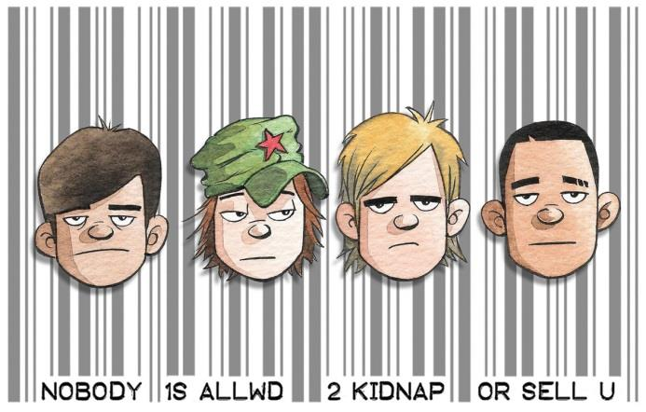
Introducing children’s rights
Course contents
Purpose
Introduction
Rights
What are human rights?
International human rights
European human rights
Human rights in Scotland
How does the UNCRC work?
Children’s rights and the Scottish Government
The Children and Young People (Scotland) Act 2014
What is the Child Rights and Wellbeing Impact Assessment (CRWIA)?
Why do we need CRWIAs?
Involving children and young people
Acknowledgements
Human rights mechanisms in Europe
The European Convention on Human Rights (ECHR) - drafted by the Council of Europe in 1950 and in force from 1953 - was the first regional agreement for the protection of human rights. The primary focus of the ECHR is on political and civil rights.
This is complemented by the European Social Charter which sets out economic, social and cultural rights - what the Council of Europe calls ‘the rights of every day’, many of which are of importance to children and young people, including the right to housing, health, education, and legal and social protection.
In 2009, the European Union adopted the EU Charter of Fundamental Rights which is legally binding on EU members through the Treaty of Lisbon. The EU Charter brings together ECHR rights, rights found in Court of Justice case law, and rights and principles from international treaties and the common constitutional traditions of EU countries.
Article 35
‘Prior knowledge’ prompt
Which human rights bodies are based in Scotland?
< Back
Next >

Slide 7
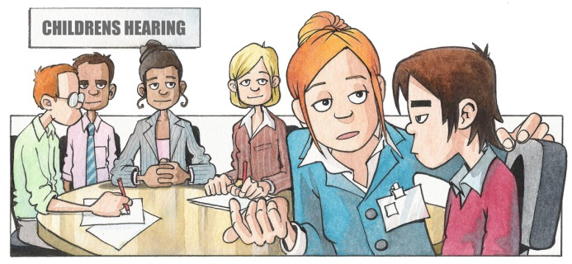
Introducing children’s rights
Course contents
Purpose
Introduction
Rights
What are human rights?
International human rights
European human rights
Human rights in Scotland
How does the UNCRC work?
Children’s rights and the Scottish Government
The Children and Young People (Scotland) Act 2014
What is the Child Rights and Wellbeing Impact Assessment (CRWIA)?
Why do we need CRWIAs?
Involving children and young people
Acknowledgements
Human rights in Scotland
The ECHR has been incorporated into UK domestic law through the Human Rights Act (HRA) 1998. It has been applied in a series of legal cases affecting children and young people, a growing number of which refer to Articles of the UNCRC.
There is a reporting cycle for Scottish commitments to the various UN and European human rights monitoring Committees (as part of the UK-wide reports). To inform our human rights approaches, we can seek advice from two public bodies based in Scotland:
Article 40: Young people accused of crimes should be helped through the legal process, which should take account of the young person’s needs
The Scottish Human Rights Commission (SHRC) oversees the delivery of Scotland’s National Action Plan (SNAP) for Human Rights 2013-2017, endorsed by the Scottish Government, and in which issues that affect children and young people are highlighted.
The Equality and Human Rights Commission (EHRC) in Scotland works closely with the SHRC.
‘Prior knowledge’ prompt
Why do we need separate ‘children’s’ rights to ‘human’ rights?
< Back
Next >

Slide 8
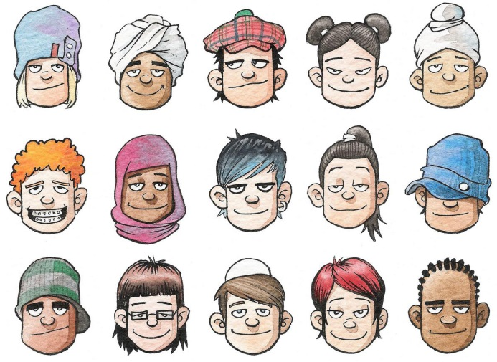
Introducing children’s rights
Course contents
Purpose
Introduction
Rights
What are human rights?
International human rights
European human rights
Human rights in Scotland
How does the UNCRC work?
Children’s rights and the Scottish Government
The Children and Young People (Scotland) Act 2014
What is the Child Rights and Wellbeing Impact Assessment (CRWIA)?
Why do we need CRWIAs?
Involving children and young people
Acknowledgements
How does the UNCRC work?
There are four general principles of the UNCRC:
apply rights without discrimination (Article 2)
best interests of the child to be a primary consideration (Article 3)
right to life, survival and development (Article 6)
right to express a view and have that view taken into account (Article 12).
Article 1: Rights for everyone under 18
Children’s rights are inextricably linked with the rights of parents and carers, whose important role in children’s lives is recognised throughout. However, Article 5 of the UNCRC introduces the concept of a child’s ‘evolving capacities’ as they grow older, to exercise rights on their own behalf.
It also provides children with a series of individual rights - such as to a name and nationality, to education, to health, to play and recreation, and to an adequate standard of living - alongside additional rights for specific groups of children, such as disabled children, children who have been exploited or mistreated, refugee and migrant children, children in custody, and children in care.
‘Prior knowledge’ prompt
Who is Scotland’s Independent Commissioner for Children and Young People and what is his role?
< Back
Next >

Slide 9
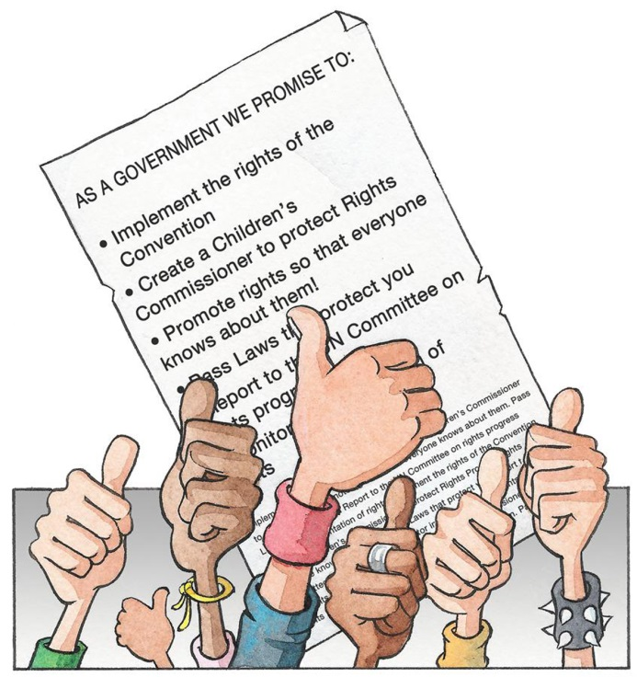
Introducing children’s rights
Course contents
Purpose
Introduction
Rights
What are human rights?
International human rights
European human rights
Human rights in Scotland
How does the UNCRC work?
Children’s rights and the Scottish Government
The Children and Young People (Scotland) Act 2014
What is the Child Rights and Wellbeing Impact Assessment (CRWIA)?
Why do we need CRWIAs?
Involving children and young people
Acknowledgements
Children’s rights and the Scottish Government
The Scottish Government was last examined by the UN Committee on the Rights of the Child in May 2016, as part of UK reporting, and the Committee produced a set of Concluding Observations. These will be used to inform the actions we plan to take going forward. We are due to be next examined in May 2021.
Scotland created an independent Children and Young People’s Commissioner Scotland (CYPCS) in 2004 - to promote and safeguard the rights of children, with particular emphasis on the UNCRC.
Scotland’s current Commissioner is Bruce Adamson. New powers of investigation into rights issues will be commenced by Autumn 2017. Meanwhile the ‘7 Golden Rules for Participation’ are a set of principles that can help anyone working with – and for – children and young people.
Article 4: The Government has promised to make rights a reality for all young people
‘Prior knowledge’ prompt
How are UNCRC rights formally embedded within Scottish Legislation?
< Back
Next >

Slide 10
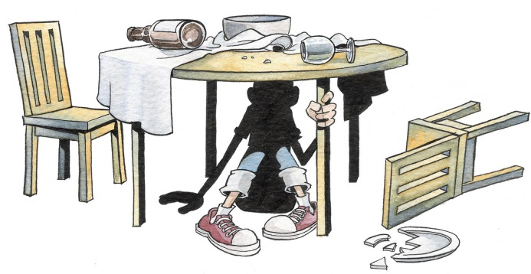
Introducing children’s rights
Course contents
Purpose
Introduction
Rights
What are human rights?
International human rights
European human rights
Human rights in Scotland
How does the UNCRC work?
Children’s rights and the Scottish Government
The Children and Young People (Scotland) Act 2014
What is the Child Rights and Wellbeing Impact Assessment (CRWIA)?
Why do we need CRWIAs?
Involving children and young people
Acknowledgements
The Children and Young People (Scotland) Act 2014
The 2014 Act places in statute key elements of Getting It Right for Every Child. GIRFEC is Scotland’s national approach to improving the wellbeing of children, and was built up from the UNCRC. Amongst its most important principles are:
putting the best interests of the child at the heart of decision-making
Article 19: You have the right to be protected from abuse or neglect by parents or carers
taking a holistic approach to the wellbeing of a child.
The 2014 Act is an example of so-called ‘rights-based’ legislation and is a milestone for children’s rights in Scotland. Under Section 1(1) our Ministers have a duty to:
give better or further effect to the requirements of the UNCRC
take account of the relevant views of children of which they are aware
promote public awareness and understanding of the rights of children.
Our new Child Rights and Wellbeing Impact Assessment (CRWIA) helps fulfill the existing UNCRC and the new Ministerial duties under the 2014 Act.
‘Prior knowledge’ prompt
Both ‘rights’ and ‘wellbeing’? Why are we using two different frameworks in developing our children’s policies and measures in Scotland?
< Back
Next >

Slide 11
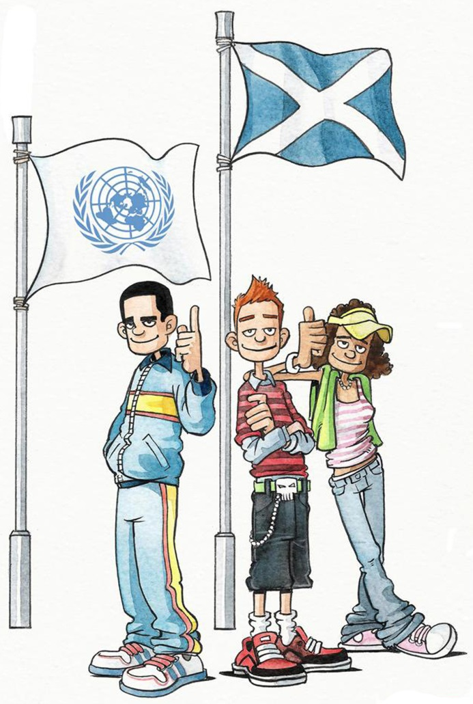
Introducing children’s rights
Course contents
Purpose
Introduction
Rights
What are human rights?
International human rights
European human rights
Human rights in Scotland
How does the UNCRC work?
Children’s rights and the Scottish Government
The Children and Young People (Scotland) Act 2014
What is the Child Rights and Wellbeing Impact Assessment (CRWIA)?
Why do we need CRWIAs?
Involving children and young people
Acknowledgements
What is the Child Rights and Wellbeing Impact Assessment (CRWIA)?
CRWIA is a purpose built policy and legislation impact assessment (IA) for specific use by Scottish Government officials. It was launched on 15 June 2015 as part of the implementation strategy for Ministerial duties under Part 1 of the Children and Young People (Scotland) Act 2014.
CRWIA covers individual children, groups of children, and all children up to age 18. It has been developed as an improvement approach, a tool and a published output, based on EQIA. It is intended to help us champion the interests of children, as well as challenge us to think about what more we can do to place children and young people at the centre of our policies.
‘Prior knowledge’ prompt
Which children’s issues might a CRWIA cover that an EQIA might not?
Article 41: Where our laws give young people more rights, we should stick with them
< Back
Next >

Slide 12
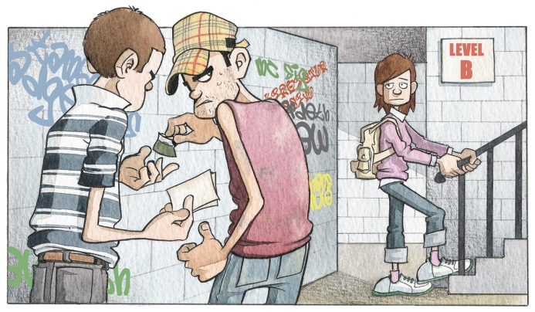
Introducing children’s rights
Course contents
Purpose
Introduction
Rights
What are human rights?
International human rights
European human rights
Human rights in Scotland
How does the UNCRC work?
Children’s rights and the Scottish Government
The Children and Young People (Scotland) Act 2014
What is the Child Rights and Wellbeing Impact Assessment (CRWIA)?
Why do we need CRWIAs?
Involving children and young people
Acknowledgements
Why do we need CRWIAs?
Ministers committed to CRWIAs as a means of delivering their children’s rights duties under the 2014 Act which embeds UNCRC rights in Scottish legislation.
The reach of the UNCRC is far wider than Equalities legislation although some categories of individuals may be covered by both, for example those with protected characteristics under the Equality Act 2010: disability, race, religion or belief, sex, sexual orientation.
Article 33: You have the right to protection from illegal drugs
The UNCRC considers all individual children or groups of children, for example by age band or setting, or those who are eligible for special protection or assistance, e.g. pre-school children, children with additional support needs, children in hospital, children in rural areas, looked after children (children in care), young people who offend, children affected by violence, drugs or alcohol, poverty or deprivation, homelessness, victims of abuse or exploitation (trafficking, economic or sexual), child asylum-seekers or refugees.
‘Prior knowledge’ prompt
When can CRWIA help with improvement planning?
< Back
Next >

Slide 13
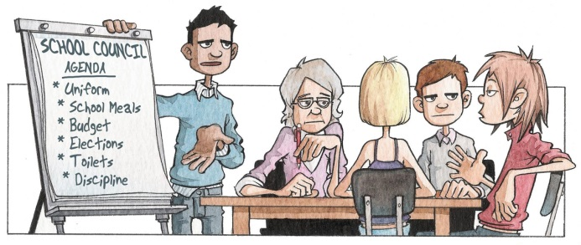
Introducing children’s rights
Course contents
Purpose
Introduction
Rights
What are human rights?
International human rights
European human rights
Human rights in Scotland
How does the UNCRC work?
Children’s rights and the Scottish Government
The Children and Young People (Scotland) Act 2014
What is the Child Rights and Wellbeing Impact Assessment (CRWIA)?
Why do we need CRWIAs?
Involving children and young people
Acknowledgements
Involving children and young people
Under Article 12 of the UNCRC, every child has the right to be heard in matters affecting them and to participate in the life of their family, community and society. The Children and Young People (Scotland) Act 2014 embeds this child’s right in primary legislation, and places requirements on Scottish Ministers in relation to policy and service development and services planning, including grant-funded work.
Article 12: You should have a say in decisions that affect you
The Ministerial duty is supplemented by a Scottish Government expectation that, where children and young people’s views are not known on a matter that is likely to have an impact on them, steps should be taken to obtain their views.
Part 1 Guidance on the Act explains in more detail rights based duties and expectations in relation to public bodies, including engagement with children and young people.
Further information on engagement with children, both use of existing evidence, and undertaking consultation work, is in the Quick Reference Guide, which also highlights the Common Core of skills and values needed to work with children.
< Back
Next >

Slide 14
Introducing children’s rights
Introducing children’s rights - Acknowledgements
Course contents
Purpose
Introduction
Rights
What are human rights?
International human rights
European human rights
Human rights in Scotland
How does the UNCRC work?
Children’s rights and the Scottish Government
The Children and Young People (Scotland) Act 2014
What is the Child Rights and Wellbeing Impact Assessment (CRWIA)?
Why do we need CRWIAs?
Involving children and young people
Acknowledgements
With thanks to SCCYP for supplying the cartoon graphics used in this training tool, which are illustrated by Alex Leonard.
Find out more about children’s rights and the CRWIA on the SG website
End of ‘Introducing Children’s Rights’
< Back

