Slide 1





Slide 2
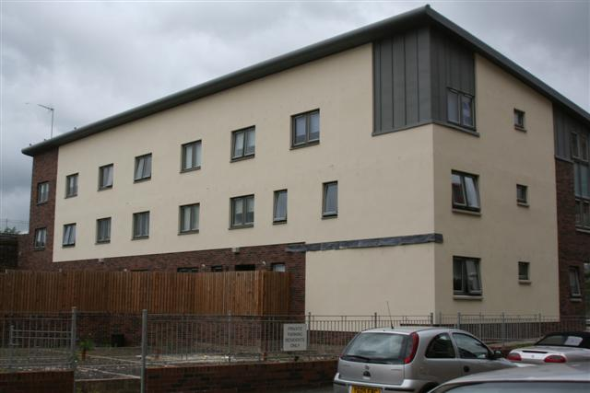
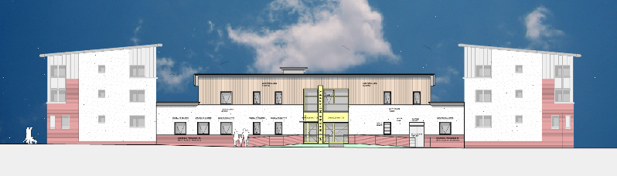
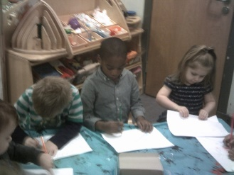
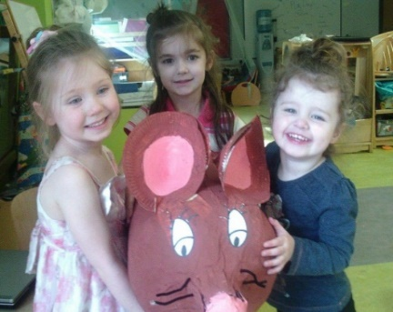

Overview
Several years ago following the re-development of the Great Eastern Building the committee were faced with the opportunity to develop a gap site for use as a community facility. High on the agenda for our community at the time was a lack of affordable childcare and from this Carbon Footprints nursery was born. With support from the Big Lotto and Climate Change Fund Scotland.

Slide 3
Who we are…….
Carbon Footprint Nursery is a purpose-built, low-carbon nursery, designed to provide a high quality day-care space for children aged six weeks to five years and an after-school facility for children aged five to fourteen years old.
Ethos – Quality Childcare providers. Carbon Footprints Nursery aims to provide childcare and early learning opportunities in a secure, stimulating, creative, caring and happy environment.
Ethos - Low carbon. The main features of the building are key to the concepts incorporated in the ethos of the nursery. The design of the building includes high energy efficiency it is therefore a low carbon facility. Recycling, waste minimisation, and low energy appliances are all features that add to the low carbon profile of the nursery and hence the name: Carbon Footprints.
Ethos – Community. Carbon Footprints is a genuine community nursery, run and managed by representatives of Milnbank Housing Association. The provision of childcare within the community reflects other urgent priorities such as supporting parents back to work, raising children’s educational standards, delivering practical and effective ways of improving diet and lifestyles within the community and creating a focus for community activities.

Slide 4

Creating employment
I have been keen to explore a role in childcare and Milnbank Housing are going to support this by ensuring I can gain my qualification while continuing in my current role. I joined the nursery after applying for a vacancy and I now work as the cook and have the opportunity to secure a new career.
We have now established a settled team of 19 part time and fulltime positions and all of our team receive the living wage for Glasgow
2 team members are MHA tenants and 3 are children of MHA tenants
The staff team consists of
8 staff from the immediate local area and a further 9 from the East End or North East of Glasgow.
In addition to the permanent team, we have been able to offer students some part-time temporary work to cover holiday periods.
Investing in our team
Milnbank Housing Association has gained recognition for our commitment to supporting and involving our team members in the life and work of the service. We have continued to build on our previous success with the Investors in People and Investor in Young People, and have now achieved an award from Family Friendly Working Scotland as the best for childcare. Carbon Footprints is very proud of this achievement as we always strive to ensure our team can achieve the best work life balance possible

Slide 5
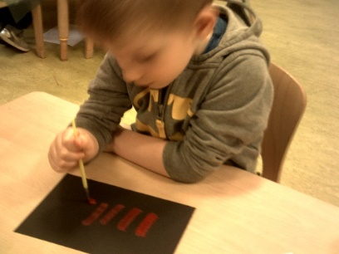
Student Placements
The service has worked closely with 3 further education colleges to ensure that we can provide placements which support the learning and training of each student. In addition to the local colleges we have also supported 4 individuals who are completing their Primary teaching qualification. In total 8 students were on placement this year. Placements allow those training to enter the sector the opportunity to gain practical experience and develop their skills. Many of the students are attending our local college or university and live in the local area.
Employability Placements
The association continues to work alongside services who offer support to young people and adults who are not working or in education. Our partners at Jobs and Business Glasgow provide employability courses and training. In the past year of operating the service have supported 5 young people by providing them with practical work experience allowing them the opportunity to gain experience and develop various skills. One of these young people has secured a post as a Modern apprentice with the service.
Providing training for young people
One of the key objectives for the project is creating jobs for the community. Carbon Footprints are currently supporting a Modern Apprentices to gain a recognised qualification in Childcare. This will improve their chances of securing employment in the sector. The Modern Apprentice receive time off the floor to carry out research relevant to their studies and enjoy an enhanced remuneration package. In the past year two of our Modern Apprentices gained their qualifications and both have now secured positions with us. In addition to this we have been able to support a further two people who have been interested in careers out with the sector with general work placement experience.

Slide 6
Our Families
Currently 105 families use Carbon Footprints Nursery and Out of School Club allowing them to maintain employment or access further education. While most are in a situation of employment some parents are furthering their career prospects through further education.

Slide 7
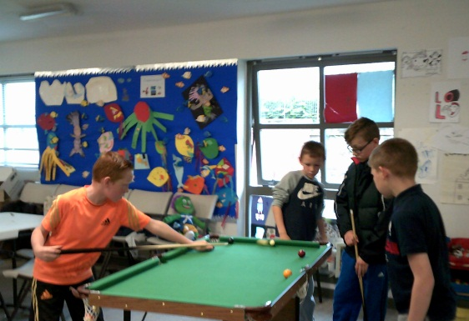
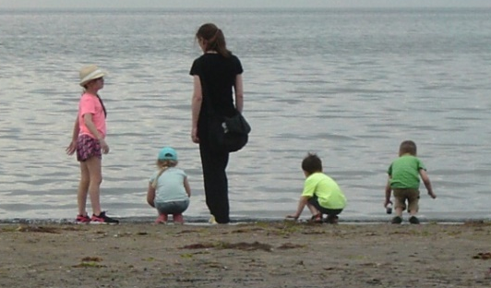
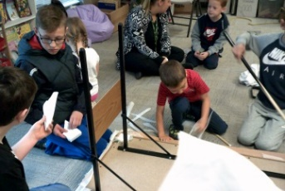
Holiday Club and Out of School
There is a growing appreciation of the complexity of play and its significance in childhood. ‘Playing for Real: Glasgow’s Play Strategy’ highlights the importance of play and the benefits to the child’s development having access to quality play experiences.
Out of School Care provision can provide a safe, challenging, stimulating environment that offers quality play experiences both indoors and outdoors.
Our exciting holiday program for school age children provides a safe environment for young people up to the age of 14.
Children have benefitted from a variety of activities which have been identified by local young people as being of interest to them.
Our families can have access to a dedicated computer suite Outings to bowling, local park museums and the opportunity to explore the seaside

Slide 8
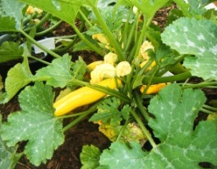
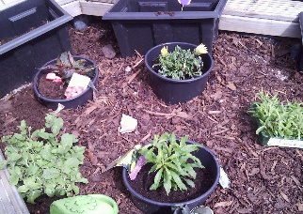
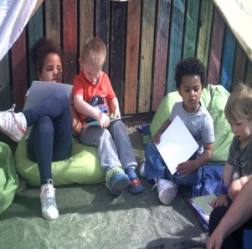
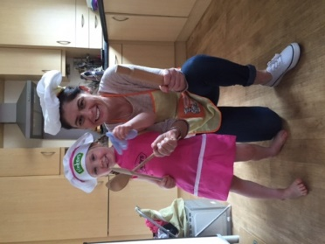
Healthy living
Our open days have now become a bi-annual event and the we take the opportunity to provide families with information and practical tips for living a healthier lifestyle.
This year we took the opportunity to promote growing our own produce at home and shared some healthy recipes that can feed a family of four for under £2.
We continue to work on our outdoor area as we recognise this is a valuable area for our children to have access to. The children asked for a den and Milnbank Housing’s Joiner helped the children build it. We also developed a performance area for our outdoor concerts.
Our Big Cook Little Cook bags help promote healthy eating at home and provide opportunities for families to cook nand explore food together

Slide 9
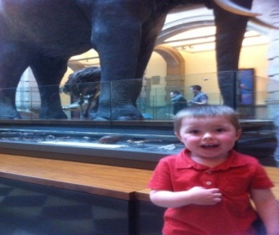
Case Study – Denise and Reece
My son has attended this nursery since he was 9 months old. An absolutely fantastic nursery in every sense, we couldn't be more happy with the service, my son loves it.
Beautiful building which is brand new, also training suites attached, staff are amazing don't know what we would do without them. I was able to use this facility to research my new business.
My son loves them, the manager supported me to become a registered childminder which enabled me to leave my job and be able to spend time at home with my family. I have attended training with the team and they have supported me with home visits to help with my registration. My life has totally changed and me and my family are extremely happy. All thanks to the nursery manager.

Slide 10
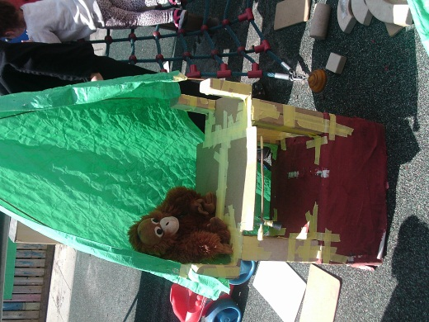
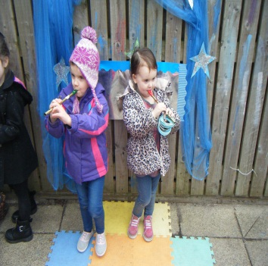
Our Community
Carbon Footprints Nursery are already establishing themselves as active members of the community. The children benefit form links with local retailers and businesses who provide information about what they do.
The Local supermarket provided an experience session which allowed the children to visit the store and learn about unusual fruit and vegetables and where they come from. The children were also invited to join the staff in their canteen for a Burns Supper.
The children have linked with the local café and were able to visit and experience eating out and to look at the kitchen and till. We even helped to decorate their windows at Halloween and Christmas.
The children purchased litter pickers and regularly go out in the local area to remove rubbish and keep our area clean.
Our parents are joining in with the service providing their expertise. This has included regular dance and drama classes and growing our own produce.

Slide 11
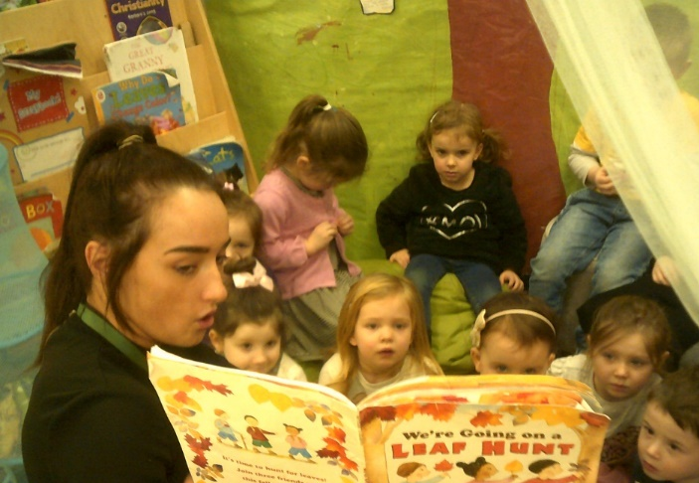
Volunteers
Volunteering offers many benefits to a community. People can learn new skills, gain work experience or simply enjoy making friends and feeling valued. Carbon Footprints Nursery offer the opportunity to participate in a number of projects. The numerous social benefits of volunteering are well documented. People who volunteer feel more active in their community and will take pride in a sense of belonging. 5 local people (including 3 parents) volunteered at Carbon Footprints Nursery in 2015/16 . The children benefitted from meeting local people who had new skills such as dance and drama.
Volunteering at Carbon Footprints Nursery since I retired has allowed me to feel like I am still involved in the community and that I still have something to offer others.

Slide 12
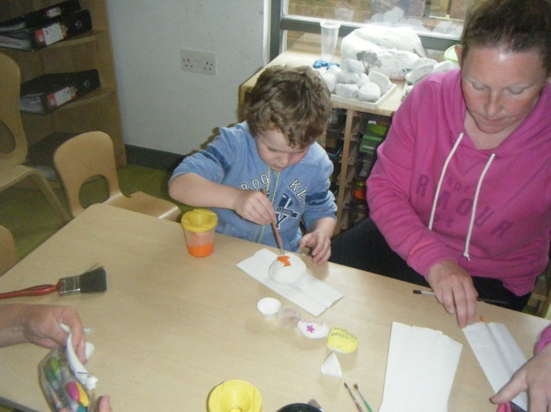
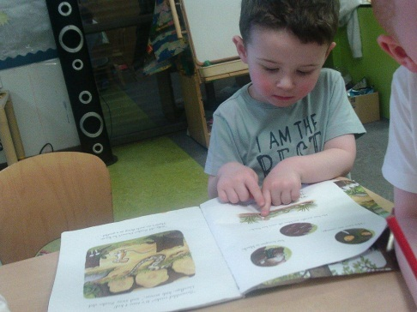
Addressing Local issues
Identified Need | Service available
Youth unemployment | Modern Apprenticeships Employability placements Student support and placement
Access to Childcare | Nursery and Holiday club provide flexible arrangements at affordable costs
Adult unemployment | 19 permanent jobs created in childcare and ancillary services
Barriers to employment | Up-skilling through volunteering and work placements

