Slide 1


Supporting Families
Sharon McIntyre
Financial Inclusion Innovation Manager
Wheatley Foundation
Date: 26th April 2018

Slide 2
Wheatley Group
/ Scotland’s leading housing, care
^{and property management group}
/ Comprises six RSLs, a care organisation and two commercial subsidiaries
/ Spans 17 local authorities across Central Scotland, providing homes and services to over 200,000 customers
/ ^{Firmly rooted in our local}
communities but use our scale to contribute to national outcomes in
^{our sectors}

Slide 3
Our Group
70.4% homes in most deprived areas of Scotland
10% Lone Parent Families
40% customers rely on welfare payments
50% households are financially excluded
70% households live near the poverty line (less than £20K)
1 in 4 tenants of working age are in work
3

Slide 4

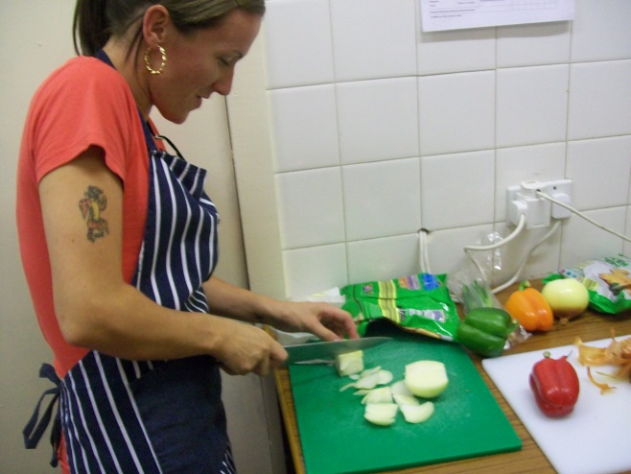
Wheatley Foundation: Better Lives for All!
Wheatley Foundation set up in 2016 to support disadvantaged Wheatley communities and tackle poverty
Foundation supports a range of programmes across central Scotland
Is funded by Group companies
Value for Money: Maximise external grants – including ESF
4

Slide 5
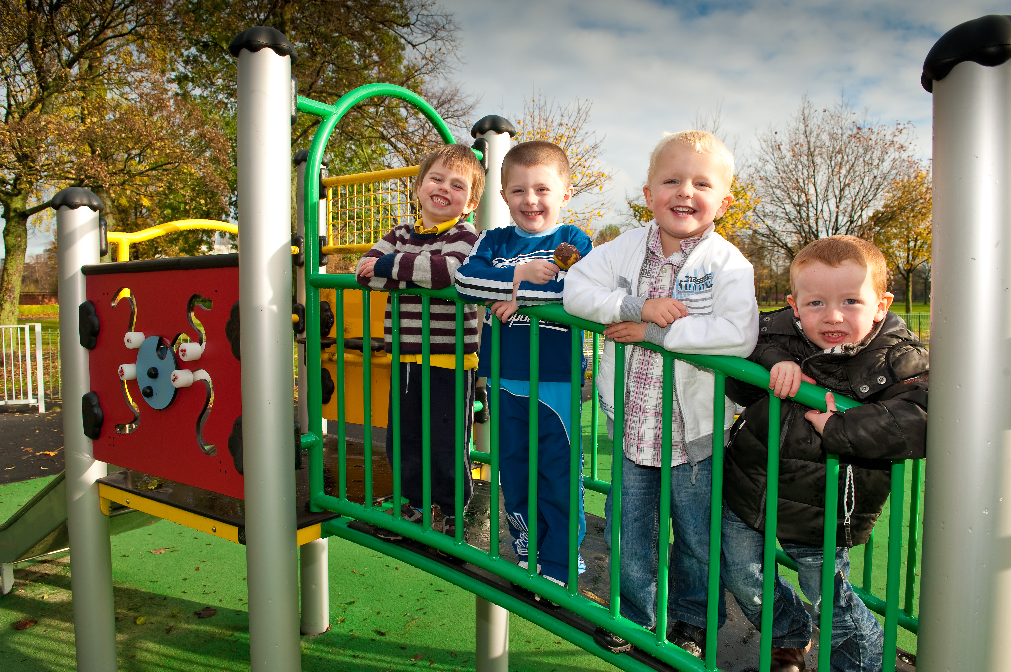
Our approach to supporting families
Earlier the better. Supporting families at the earliest possible opportunity to help strengthen their capacity to cope with fluctuating incomes.
Enablement & Empowerment. Develop services and products with families to ensure they are able to lead their own change and to develop their own solutions with our help.
Rich menu of support. Choice based. Ensuring we have a range of services that meet a range of household needs.
Value for Money. Impact & Results. Services must demonstrate they make a difference.
5

Slide 6
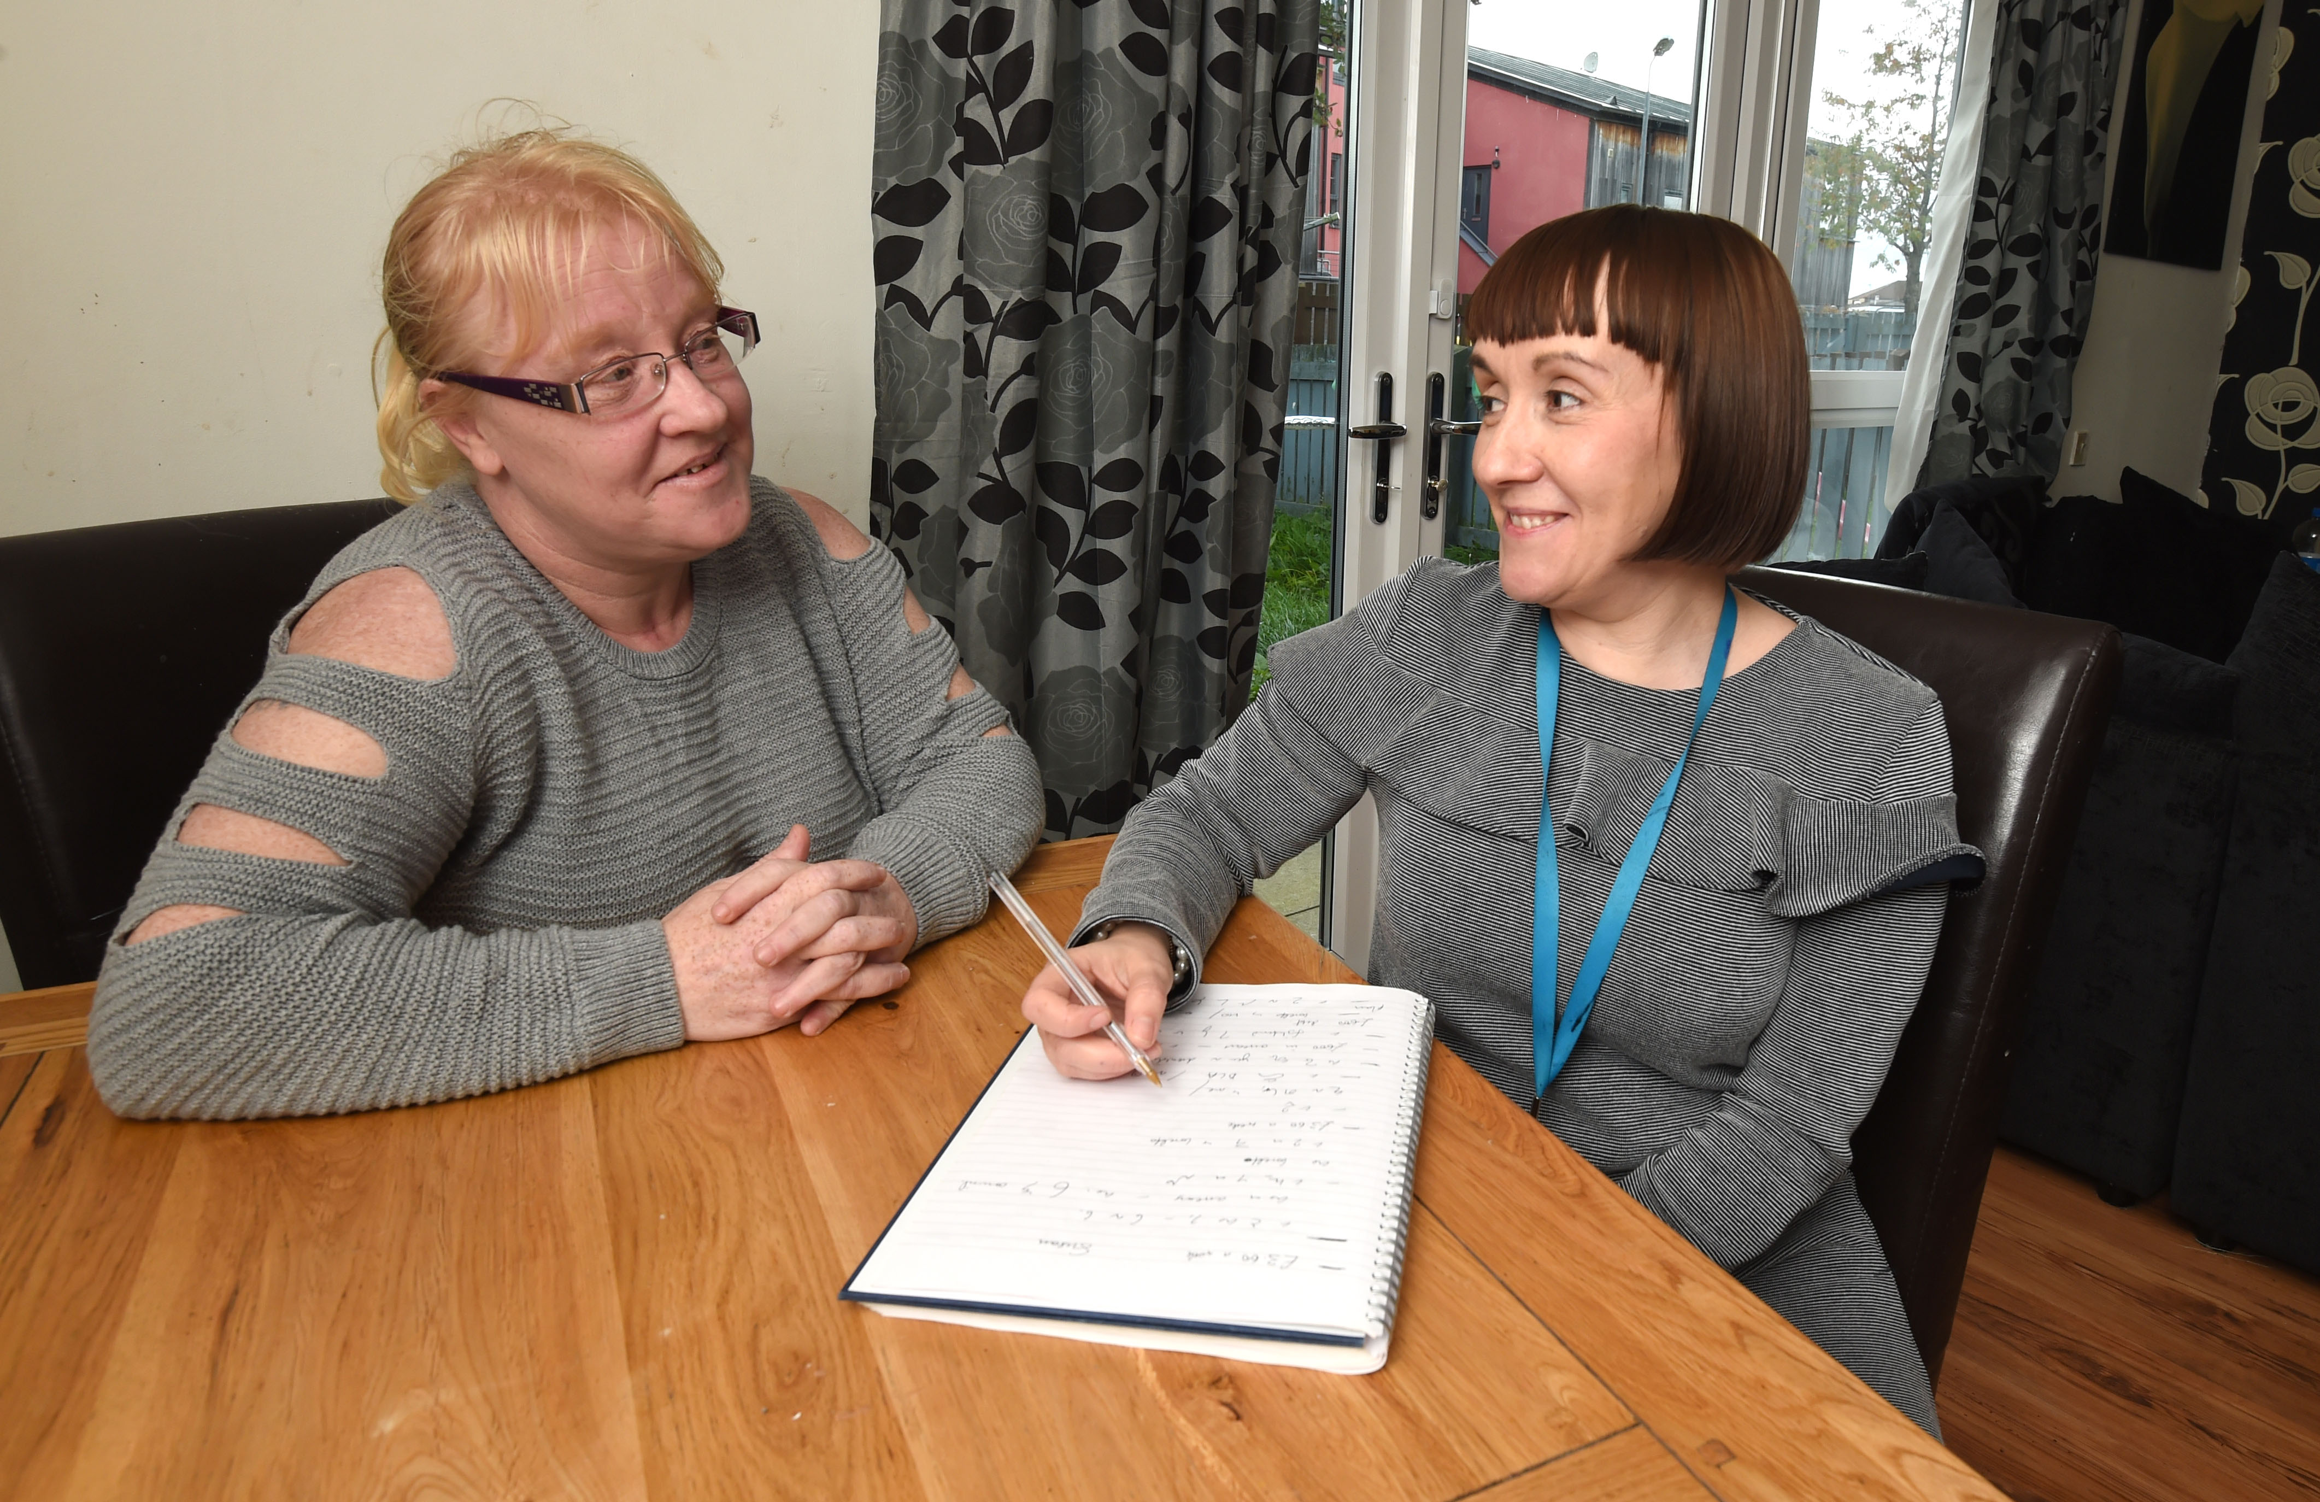
Our Services: Managing Family Finances
Group Wide Welfare Benefit Advisory Service!
My Great Start! My Money!
6
Notes:
Welfare Benefit Advisory Service. Longest standing personalised support service set up to support households maximise their income through welfare payments. Team of 22 advisors ensuring all households have direct access to welfare rights based advice.
My Great Start. New tenant financial capability service. A bespoke 121 independent service that supports all new tenants get the best out of their finances. This could includes support with money management/coaching, tackling debts, entitlements to benefits, energy awareness, external grants and support access wider services (GP’s, Dentists etc).
My Money. BIG Lottery/ESF Poverty and Social Inclusion service developed to introduce a new mentoring approach into supporting households manage their money and tackle debts. Team of 9 mentors across Glasgow communities supporting those households who want to change their relationship with money.

Slide 7
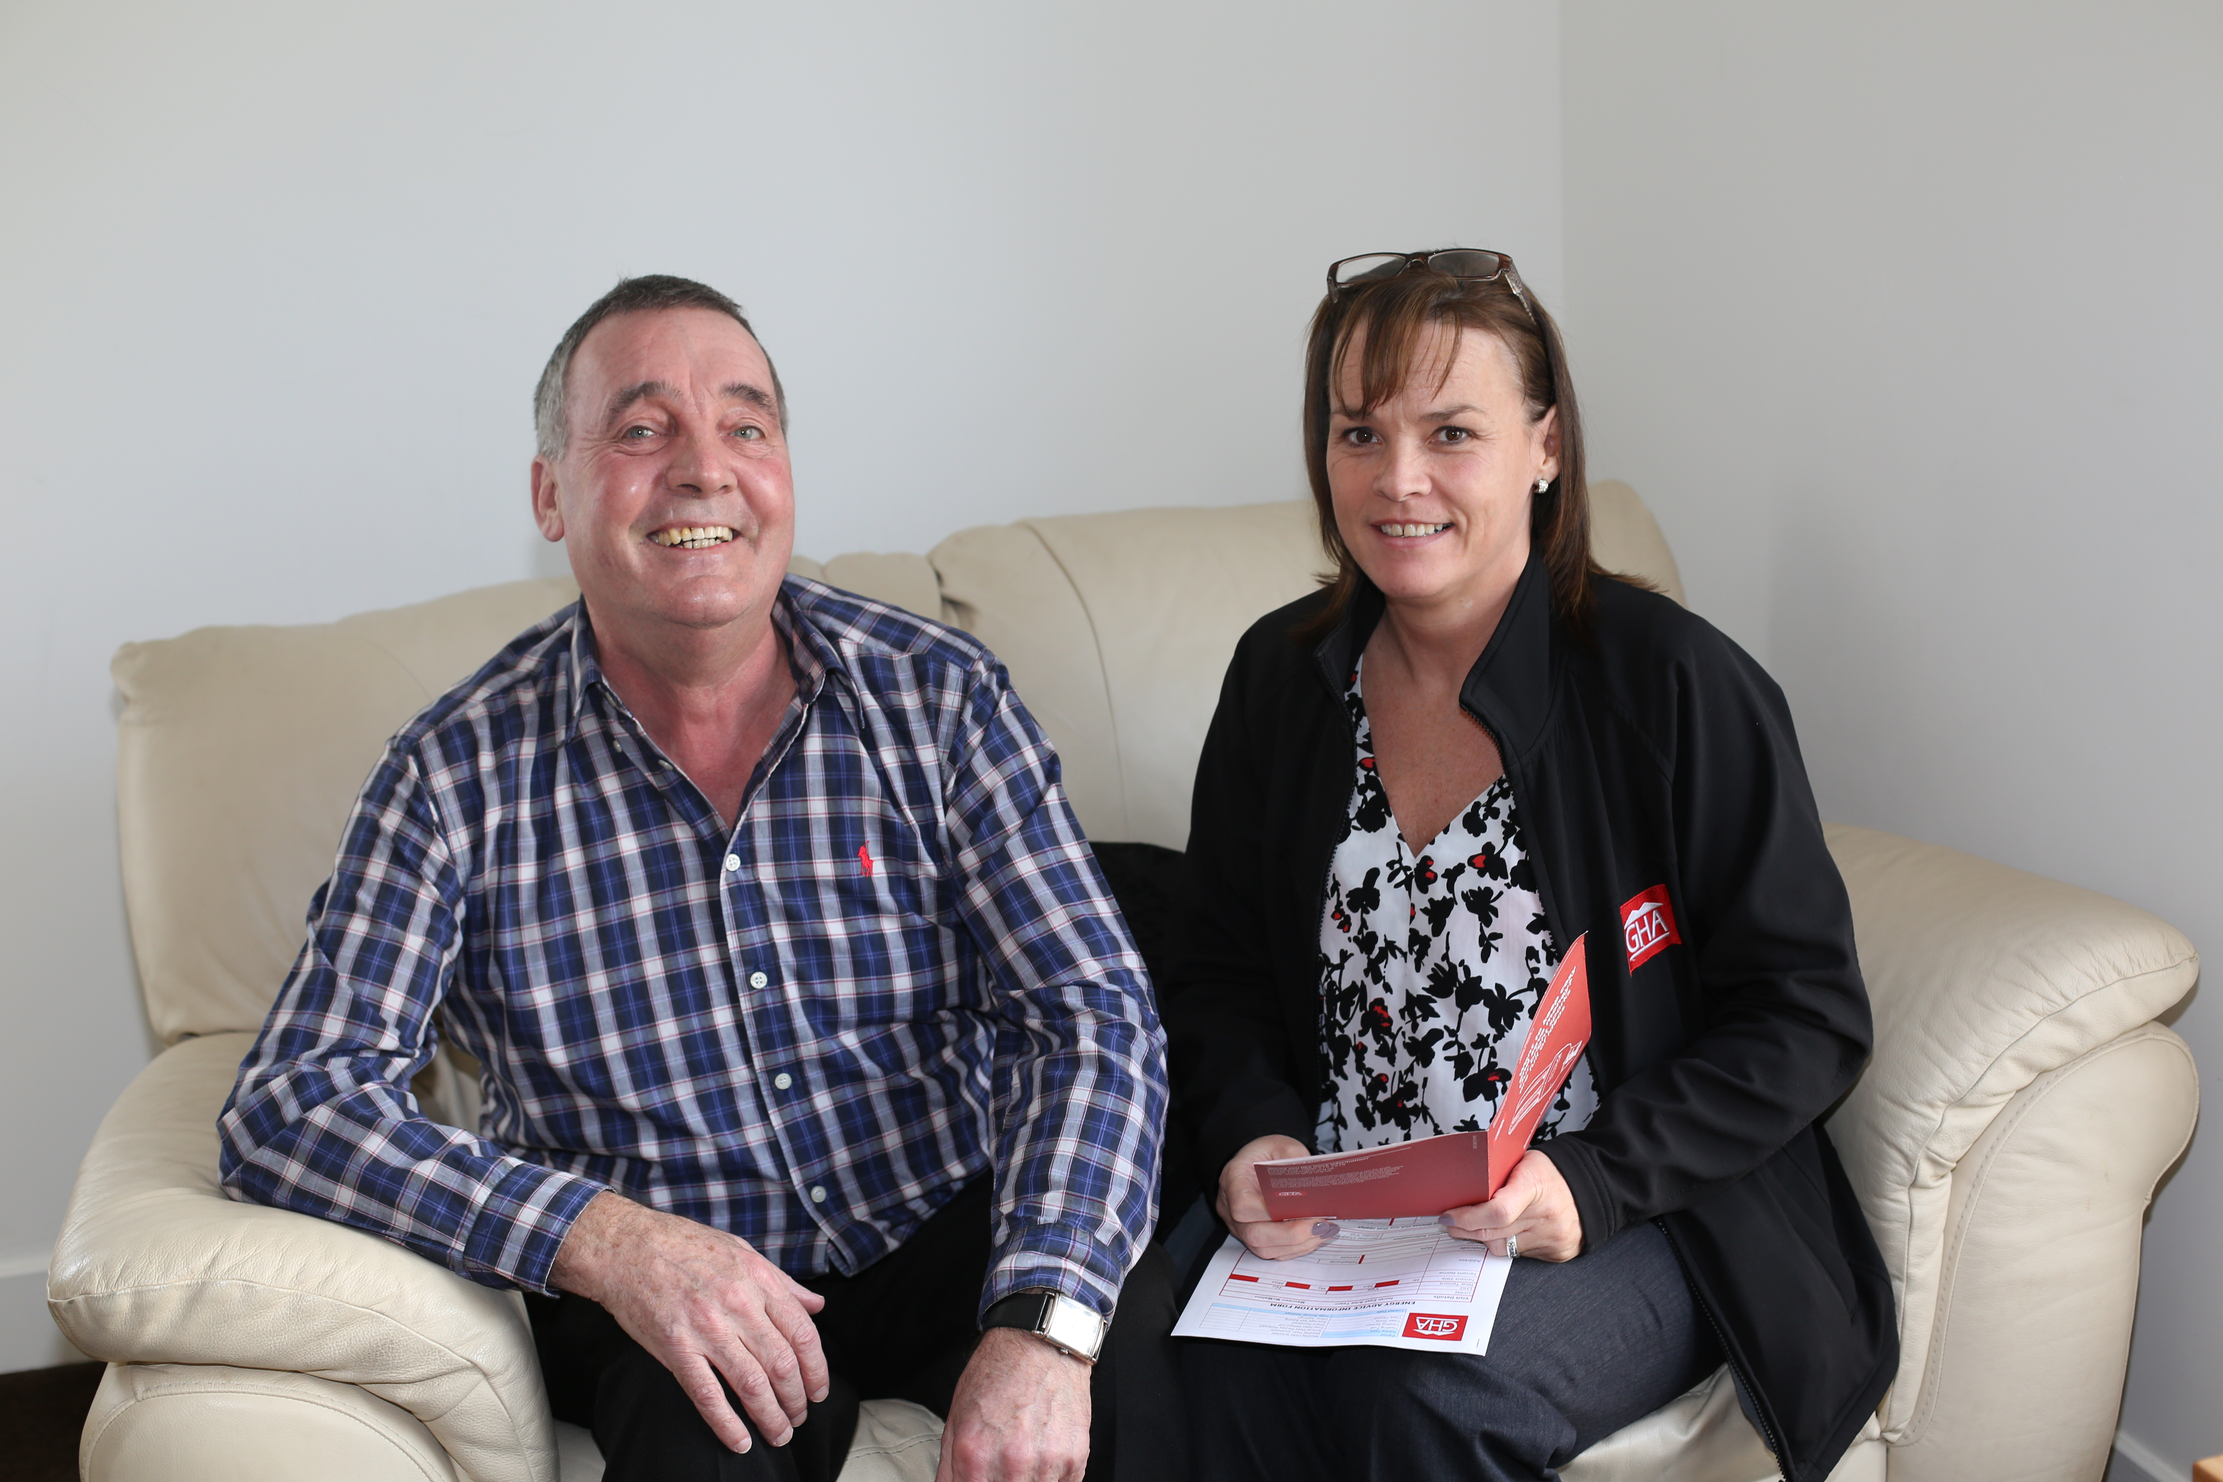
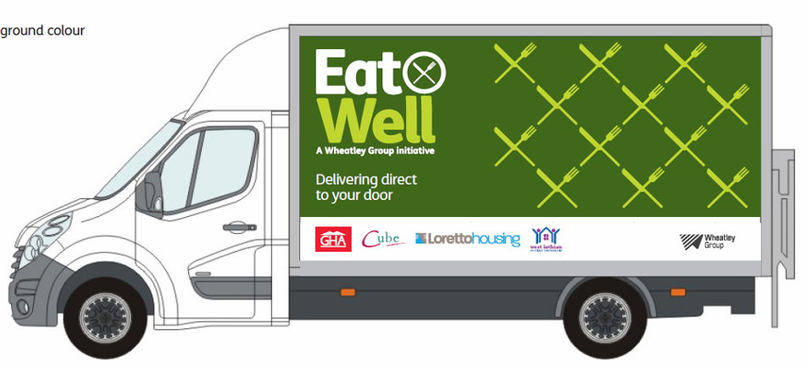
Our Services: Wider Support
Eat Well! Home Comforts!
Fuel Advice!
7
Notes:
Team of 8 advisors working across local communities to help households manage their fuel consumption in an energy efficient way. Ensuring all households are free of fuel poverty.
Eat Well Service. All Group RSL customers within Glasgow have access to food deliveries from Eat Well. Customers can be referred to Eat Well for up to 8 weeks and, during this time the customer is supported by other wraparound services to tackle their immediate financial pressures. Each week, a bag of surplus fresh, frozen and ambient food is delivered free of charge directly to the customer’s home.
Home Comforts Service. Home Comforts was established in 2013 with the aim of providing recycled furniture and white goods to vulnerable customers. Providing furniture free of charge to our customers in the most financial hardship enables us to support them to create a home and sustain their tenancy longer.

Slide 8
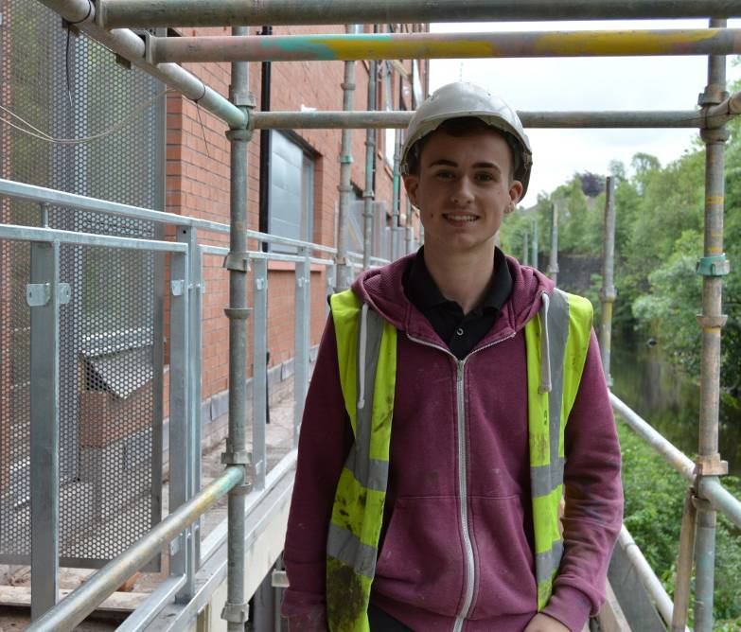
And Even Wider…..Working Families
            Changing Lives Programme. A 12 month training placement within our Environmental teams aimed at unemployed household family members that have little/no work history – paying Living wage. 45 placement opportunities per year.
Glasgow Centre for Inclusive Living. Work experience programme aimed at working age family member customers with a disability. 9 month placement within an office environment, paying Living wage.
Wheatley Pledge. Wage incentive offered to employers that recruit unemployed families of customers and pay Living wage – no minimum hour contracts are supported.
Bursary Programme. 2 year financial support to customers studying HNC or above at College / University.
8

Slide 9
And more….. targeted family support
Created new Credit Union in partnership with Pollok Credit Union to fill a gap in support for families and households in Maryhill -tackling sub-prime lending hotspot.
Introduced new GP Money Advice service ‘Deep End Pilot’, working with HSCP, GCC and GP’s to help families who suffer from long term illnesses in North East Glasgow.
Created ‘Fee Free Banking’ campaign. To support families take up the best banking options for them. Especially those families affected by UC.
Introduced Welfare Reform Hotline at the height of changes to benefit system. Help families worried about how public policy changes affect them, can access instant support.
Designed ‘Cost of Running Your Home’ guide with customers to ensure all families have handy tips and advice to hand – anytime they may need it.
9

Slide 10
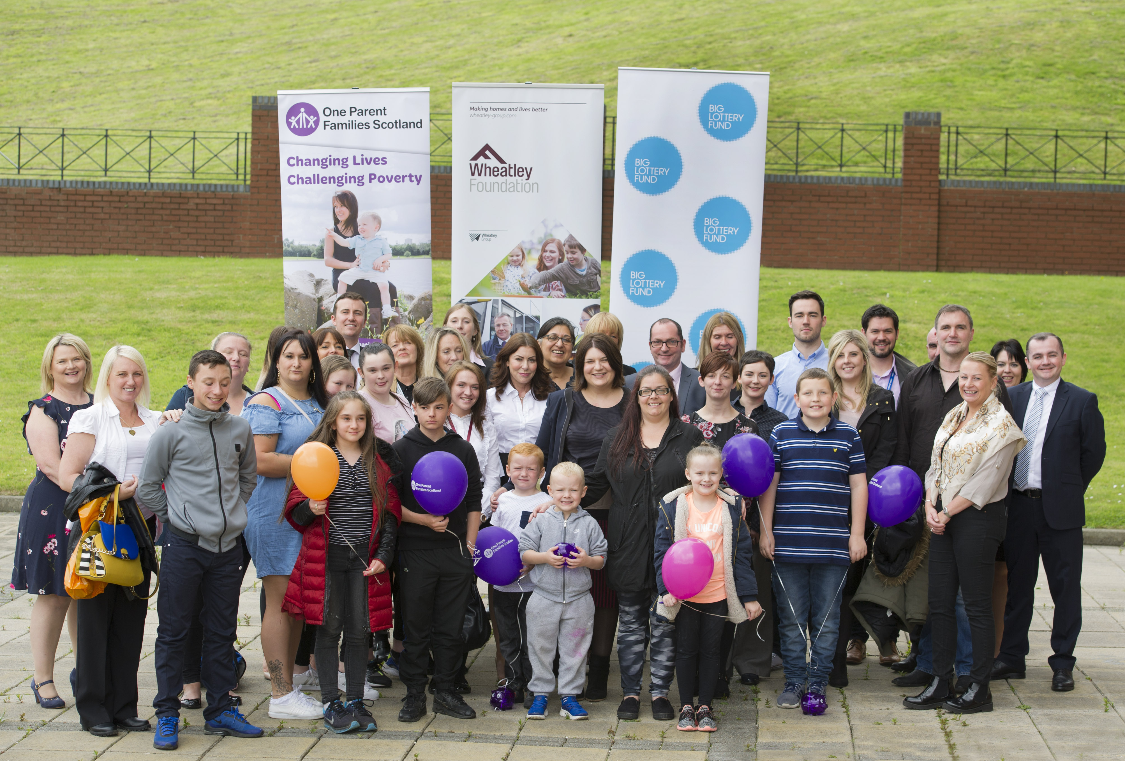
Not just Wheatley services – Partnerships
MacMillan Improving Cancer Journey: service supporting families affected by cancer with income maximisation, housing options, social care & mental health support.
Scotcash Partnership & Pollok Credit Union ‘Wee Glasgow Loan’: new low cost affordable credit version of high cost payday loans– saving families £££ hundreds of pounds per year.
Housing Partners leading benefit take up campaign: ‘Your Entitlements’ to ensure households could easily access the benefits they qualified for.
One Parent Families Partnership: helping Lone parent households understand their rights, take up support, join local hubs and avoid benefit sanctions.
10

Slide 11


