Slide 1
Supporting Families
Workshop
Jana Chandler, M.Ed.
Midlothian Sure Start

Slide 2
Midlothian Sure Start
Children and their families are at the heart of what we do.
To help each child achieve their full potential by having valued, confident and collaborate staff who will work with each other and other agencies to provide best quality service to children and their families within the communities of Midlothian.

Slide 3
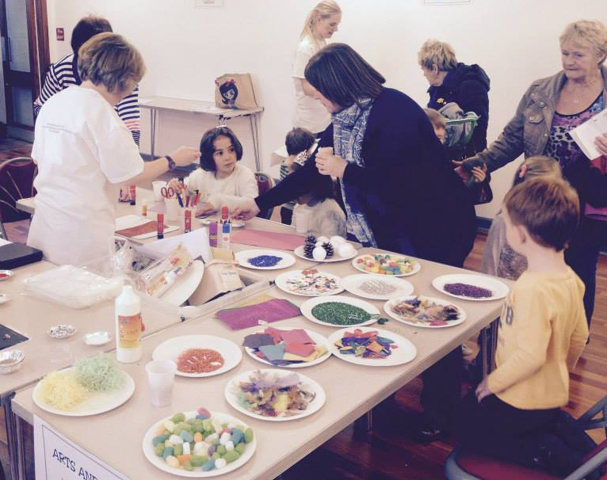
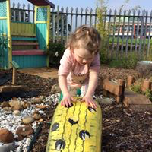
Services MSS provide
A Good Time To Be 2 provision
Respites
Peer support groups
Counselling (individual or couple)
Therapy services
Dynamic Dads
Dads to be service
Parenting courses
Family learning
ESOL
Support into work
Empowering families
Extending services:
Ante-natal support
Financial support
Work collaboratively with other agencies
Early intervention – acting now

Slide 4
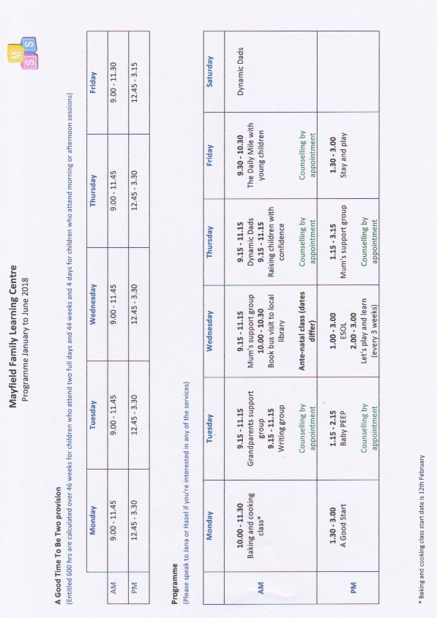
Programme

Slide 5
Approaches to engage parents
Making ourselves visible and known within the community
Understanding the local context
Effective referral system
Joined work with stakeholders
Flexibility in delivering our services
Inclusive sessions wrapped around family needs
Building positive and trusted relationships

Slide 6
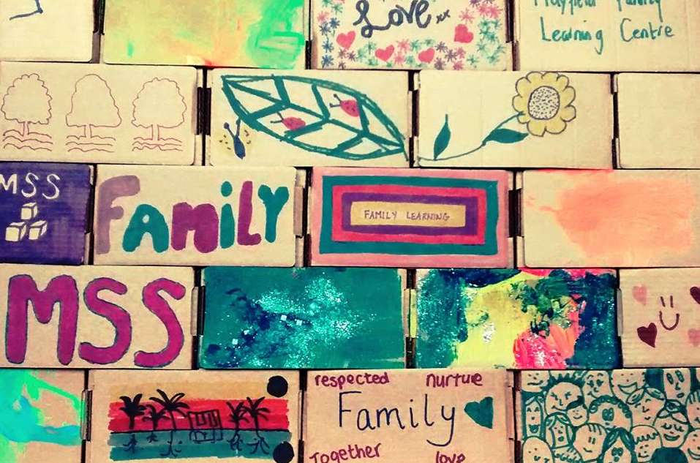
What enables us to achieve this?
Culture of the organisation
Professional development opportunities
Underpinning theoretical model
Having staff that really care about building the foundations for a happy childhood for all Midlothian children that will serve them a lifetime.

Slide 7
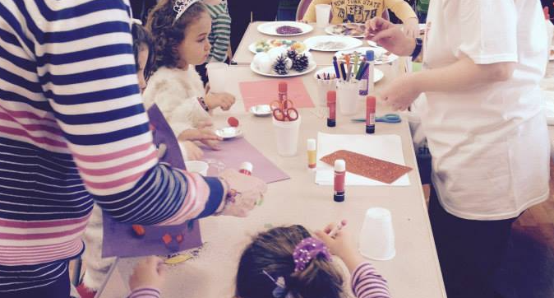
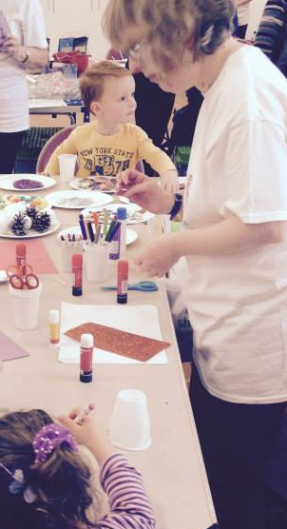
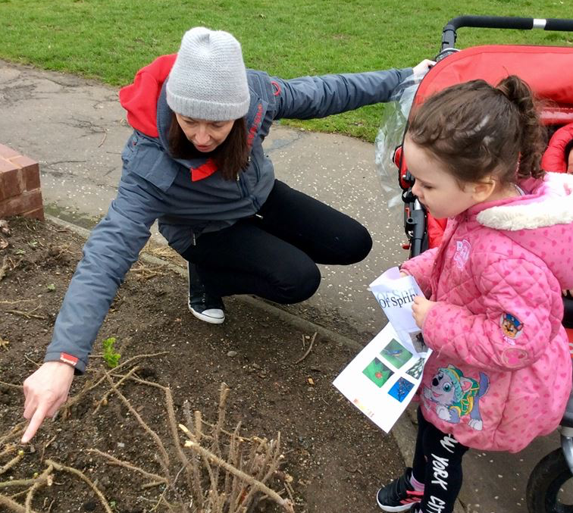
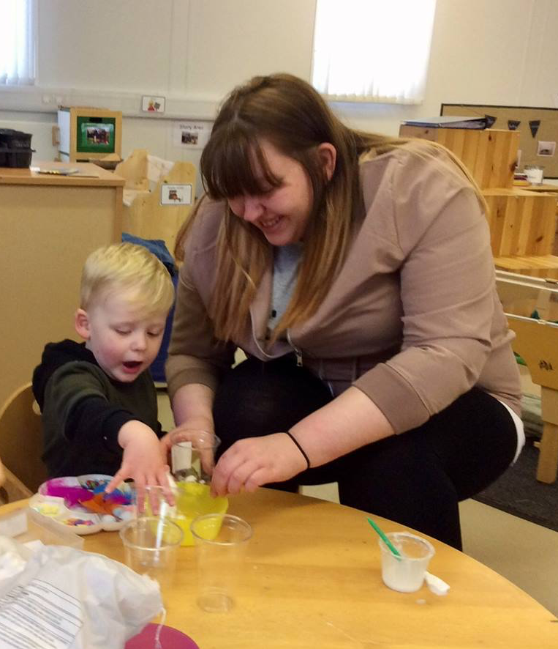

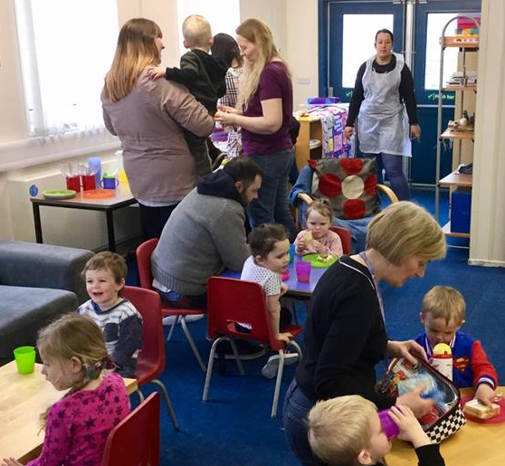
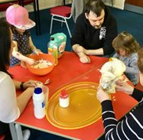
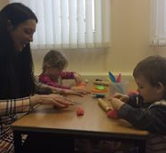
Concluding thoughts and parental input

