Slide 1
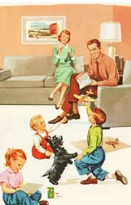
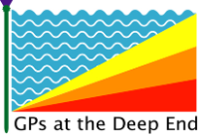
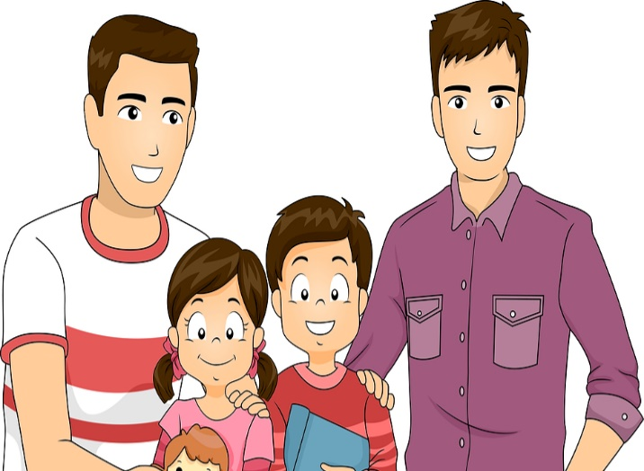
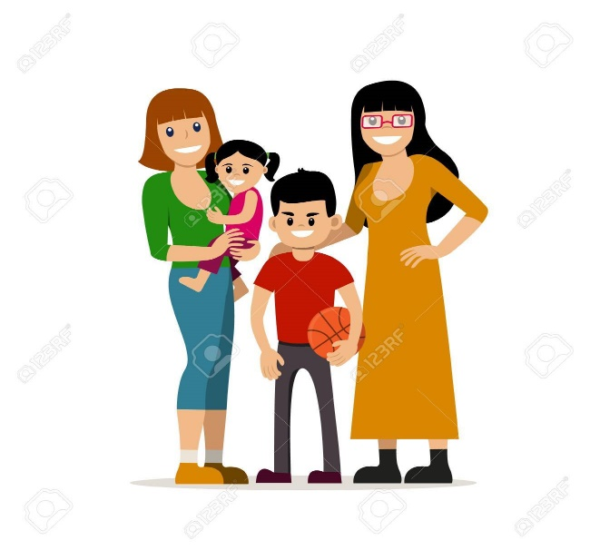
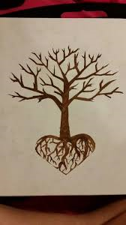
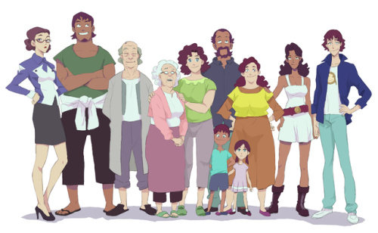
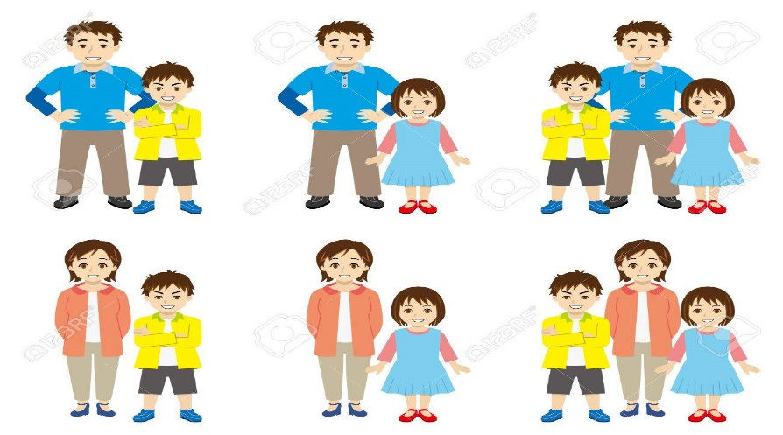
GPs In At The Deep End – Supporting Scotland’s Families. Rights, Respect, Relationships.

Slide 2
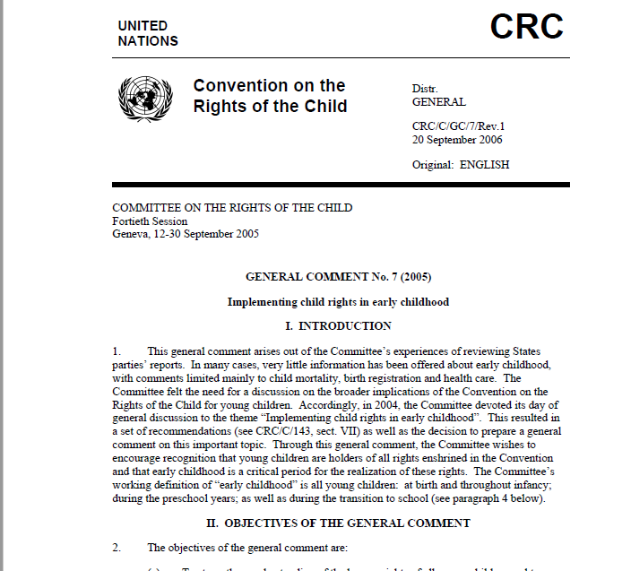
To encourage recognition of young children as social actors from the beginning of life, with particular interests, capacities and vulnerabilities, and of requirements for protection, guidance and support in the exercise of their rights;
To emphasize the vulnerability of young children to poverty, discrimination, family breakdown and multiple other adversities that violate their rights and undermine their well-being;
To contribute to the realization of rights for all young children through formulation and promotion of comprehensive policies, laws, programmes, practices, professional training and research specifically focused on rights in early childhood.
CHILDREN’S HUMAN RIGHTS ARE BEING INCREASINGLY EMBEDDED INTO EU LEGISLATION AND POLICY. THIS IS HELPING TO ENSURE THAT CHILDREN’S HUMAN RIGHTS ARE PROTECTED, RESPECTED AND FULFILLED ACROSS THE EU IN LINE WITH THE CHARTER OF FUNDAMENTAL RIGHTS.

Slide 3
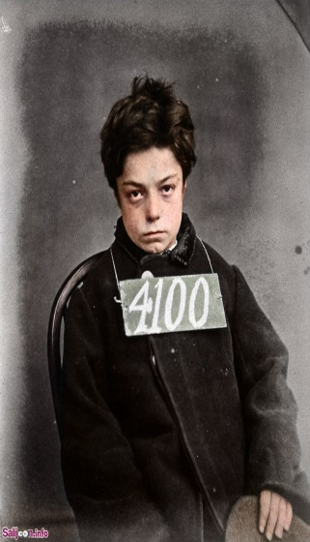
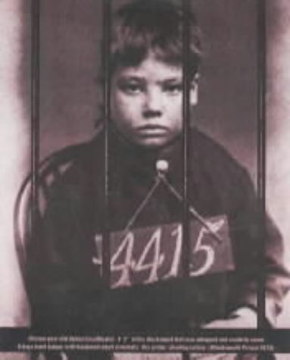
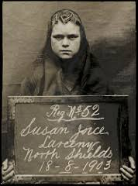
The State Discovers Child Welfare- History Matters
The 19th century was regarded as an important period of welfare reform whose philosophical approach changed from ‘rescue, reclamation and reform of children’ to the involvement of children given a new social and political identity as belonging to ‘the nation’.
1833 Factory Act, this banned children from working in textile factories under the age of nine. From nine to thirteen they were limited to nine hours a day and 48 hours a week.
The Poor Law (Amendment Act) 1868 rendered parents liable to punishment if they neglected to provide food, clothing or medical aid for their children however this responsibility was ignored by many guardians.
The 1889 Prevention of Cruelty to Children Act known as the Children’s Charter, was amended and extended to allow children to give evidence in court, mental cruelty was recognised and it became an offence to deny a sick child medical attention .

Slide 4
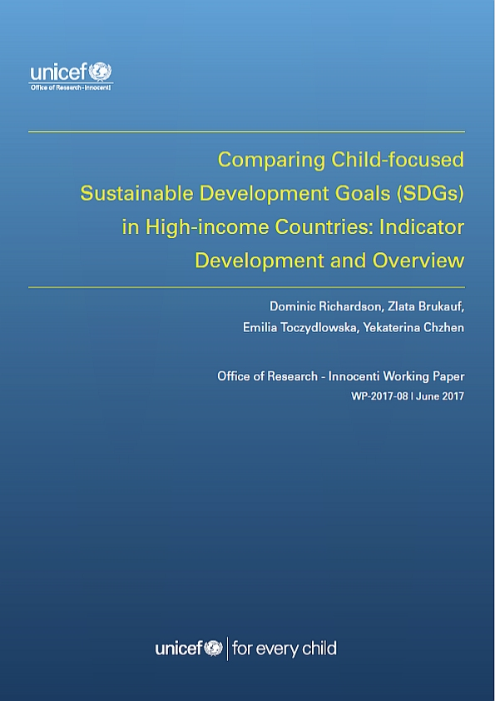
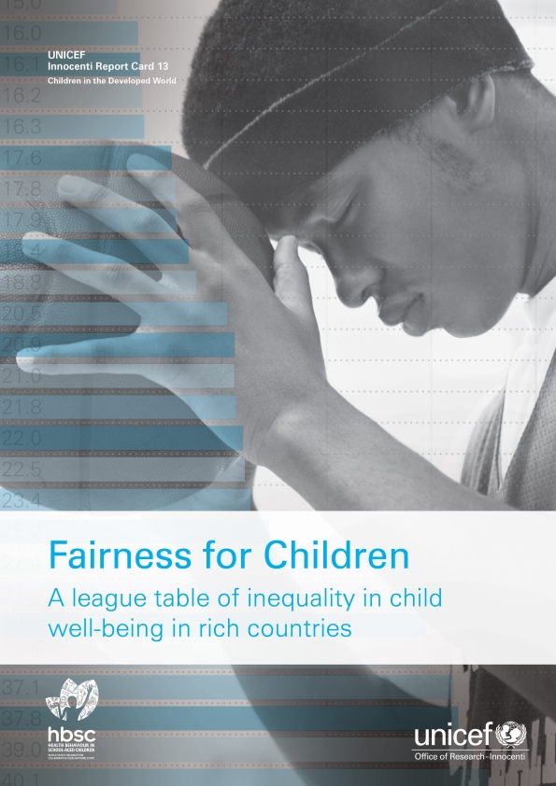
A GLOBAL AGENDA
NO POVERTY
ZERO HUNGER
GOOD HEALTH AND WELL- BEING
QUALITY EDU- CATION
DECENT WORK AND ECO- NOMIC GROWTH
REDUCED IN- EQUALITIES
SUSTAINABLE CITIES AND COMMUNIITIES
RESPONSIBLE CONSUMPTION AND PRODUCTION
PEACE JUSTICE AND STRONG INSITUTIONS
“health is a dynamic state of complete physical, mental, spiritual and social well-being and not merely the absence of disease or infirmity’ (WHO)

Slide 5
Child Health- What’s It Got to Do With General Practice ?
Health Promotion Supporting Parenting Child and Youth Friendly Services Transitional Care Safeguarding Managing Sick Children End of Life Care Disability and Complex Needs Mental Health Medicines and Prescribing
‘The RCGP firmly believes that general practice occupies a central position in children and young people’s health, particularly in the diagnosis and management of illness and the promotion of health and wellbeing. We are concerned that unless the profession acts now to protect this important and trusted role, it will become eroded and lead to serious fragmentation of care for this vulnerable group of patients’
(RCGP Child Health Strategy 2010-2015)

Slide 6

State of Child Health 2017 –Recommendations for Scotland
The Scottish Government should publish and implement the Child and Adolescent Health and Wellbeing Strategy ‘a clear accountability framework setting out responsibilities for professionals, the public and civil society as well as details about resources and funding to implement it’
Reduce the number of child deaths (each year between 350 and 450 infants, children and young people die in Scotland)
Develop integrated health and care statistics
Develop research capacity to drive improvements in children’s health
Reduce child poverty and inequality
Maximise women’s health before, during and after pregnancy
Introduce statutory sex and relationships education at all schools
Strengthen tobacco control
Tackle childhood obesity effectively
Maximise mental health and wellbeing throughout childhood
Tailor the health system to meet the needs of children, young people, their parents and carers ‘a joined-up approach by health and other agencies’
Implementing guidance and standards

Slide 7


Looking after Families in General Practice- It’s In Our DNA
The vulnerable child was never far from sight of GPs who in the era of pre-NHS chose to work in impoverished under-doctored areas without the support of a welfare state or unified health service. This was particularly true of the early female GPs who were arguably the Deep End Pioneers of their day.
They built up large lists of women and child patients by ‘squatting‘ in run down premises ‘driven by a strong social conscience to practise in a very poor area…Medical women were less hierarchical in their work ;they did things with their patients not to them’ (Anne Digby, The Evolution of British General Practice)

Slide 8
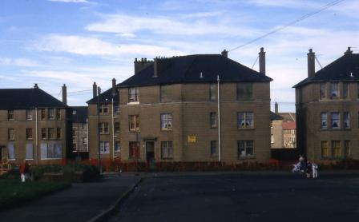
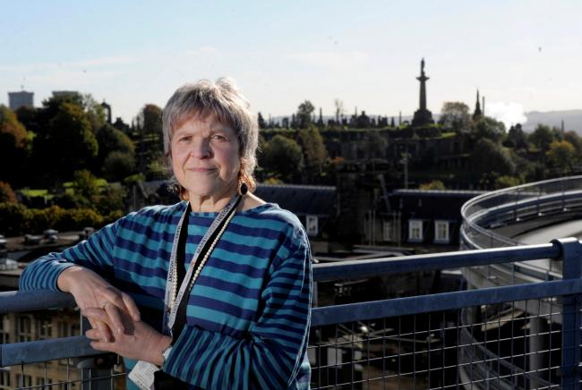
The Modern Holistic Practitioner
It began as a small clinic in Glasgow, often sneered at for the work it did to help pregnant women with drug, alcohol, HIV and mental health problems.
But the system used at Glasgow Women’s Reproductive Health Service, set up in 1990, has now helped to model similar services around the world.
The guidelines and recommendations used by the clinic, now known as the Special Needs in Pregnancy Service (Snips), are now in place UK-wide and internationally recognised as the correct way to treat socially disadvantaged mothers-to-be
http://www.heraldscotland.com/news/14777840.How_clinic_gave_birth_to_a_maternity_care_model_worldwide/.

Slide 9
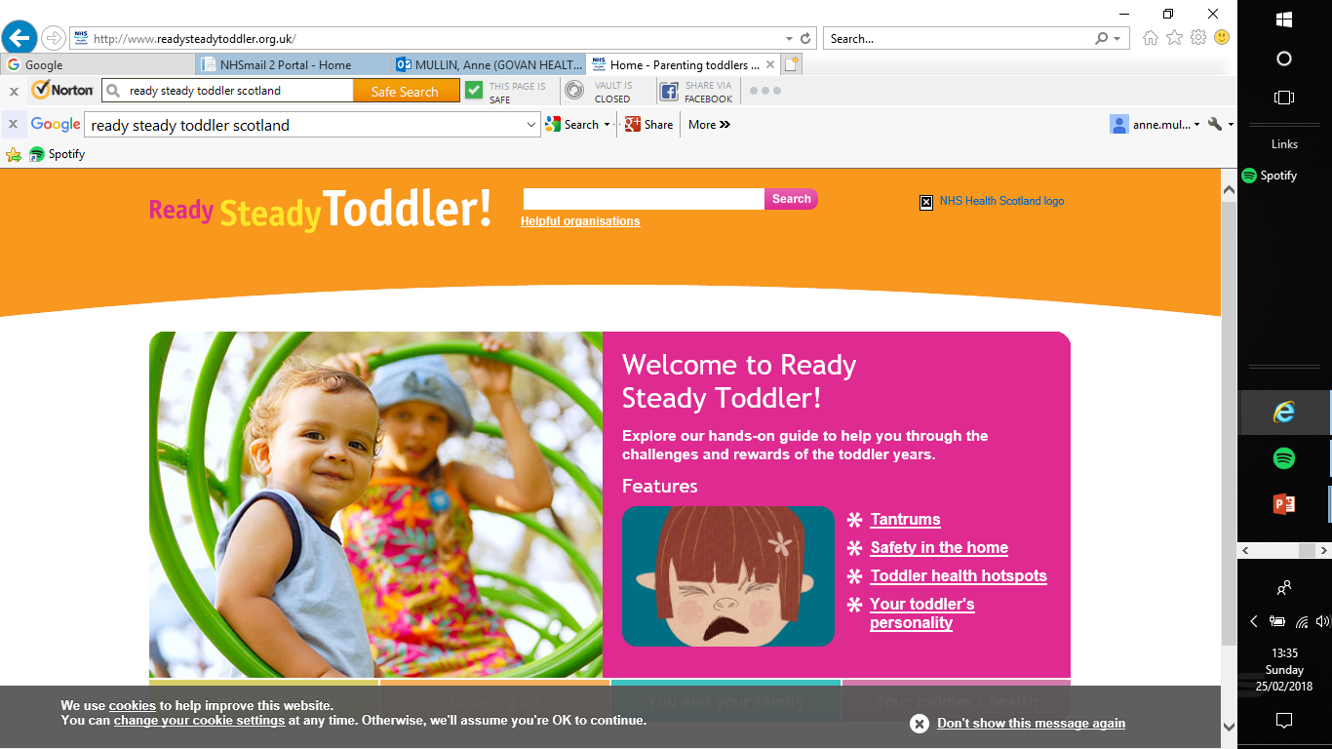
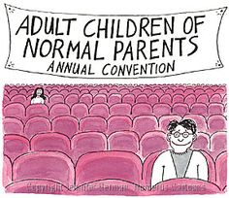
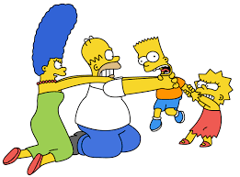
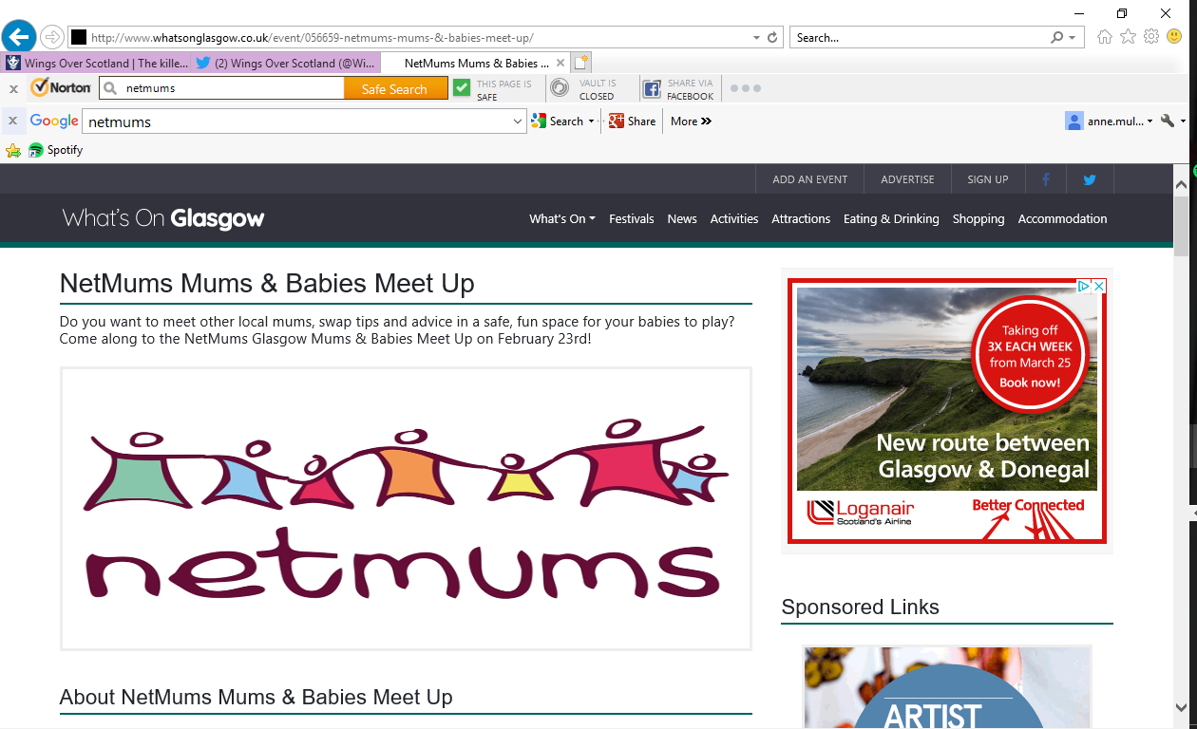
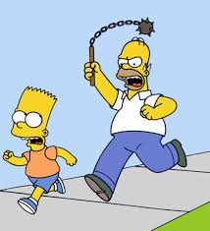
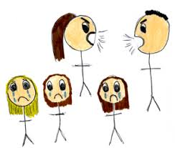
PARENTING BY THE BOOK
‘To be a good enough parent one must be able to feel secure in one's parenthood,
and one's relation to one's child...The security of the parent about being a parent
will eventually become the source of the child's feeling secure about himself.’
Bruno Bettelheim

Slide 10
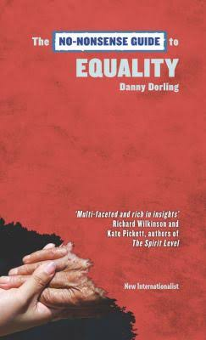


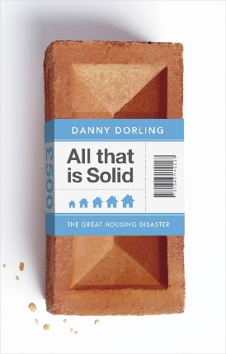


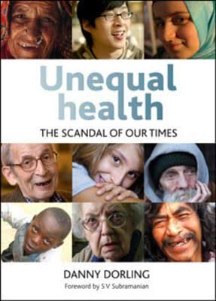
SOCIETY BY THE BOOK
‘IN A COUNTRY WHERE THE INCOME AND WEALTH GAPS HAVE BECOME GREATER THAN AT ANY POINT IN LIVING MEMORY, AND WHICH ARE GREATER THAN IN ALMOST ALL OTHER SIMILAR WEALTHY COUNTRIES, YOU SHOULD EXPECT VERY HIGH AND RISING LEVELS OF CRIME, SOCIAL DISORDER, DYSFUNCTION, RISING POLARISATION, FEAR AND ANXIETY’
http://www.dannydorling.org/?page_id=3008
‘YOUNG ADULTS IN BOTH BRITAIN AND THE USA TODAY HAVE ONLY EVER KNOWN A COUNTRY IN WHICH INCOME AND WEALTH HAVE BEEN REDISTRIBUTED FROM POOR TO RICH—TO THE DETRIMENT OF ALL. HOW MUCH MONEY COULD BE SAVED BY DOING THE REVERSE AND REDISTRIBUTING FROM RICH TO POOR?’
http://www.dannydorling.org/?page_id=3008
OUR ANALYSIS DEMONSTRATES THAT PERSONS WHO SUFFER HOUSING ARREARS EXPERIENCE INCREASED RISK OF WORSENING SELF-REPORTED HEALTH, ESPECIALLY AMONG THOSE WHO RENT. FUTURE RESEARCH IS NEEDED TO UNDERSTAND THE ROLE OF ALTERNATIVE HOUSING SUPPORT SYSTEMS AND AVAILABLE STRATEGIES FOR PREVENTING THE HEALTH CONSEQUENCES OF HOUSING INSECURITY…THESE ADVERSE ASSOCIATIONS WERE ONLY EVIDENT IN PERSONS BELOW THE 75TH PERCENTILE OF DISPOSABLE INCOME
The impact of the housing crisis on self-reported health in Europe: multilevel longitudinal modelling of 27 EU countries. European Journal of Public Health 26(5), 788-793. 1-10-2016

Slide 11
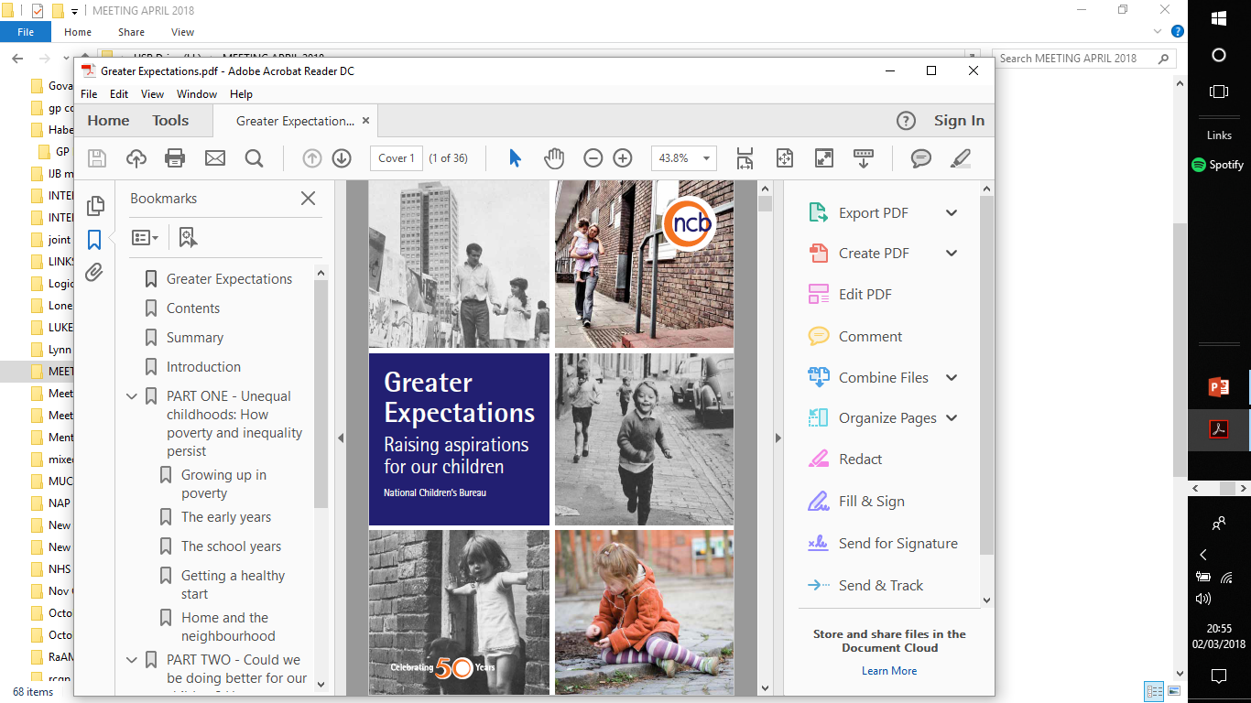
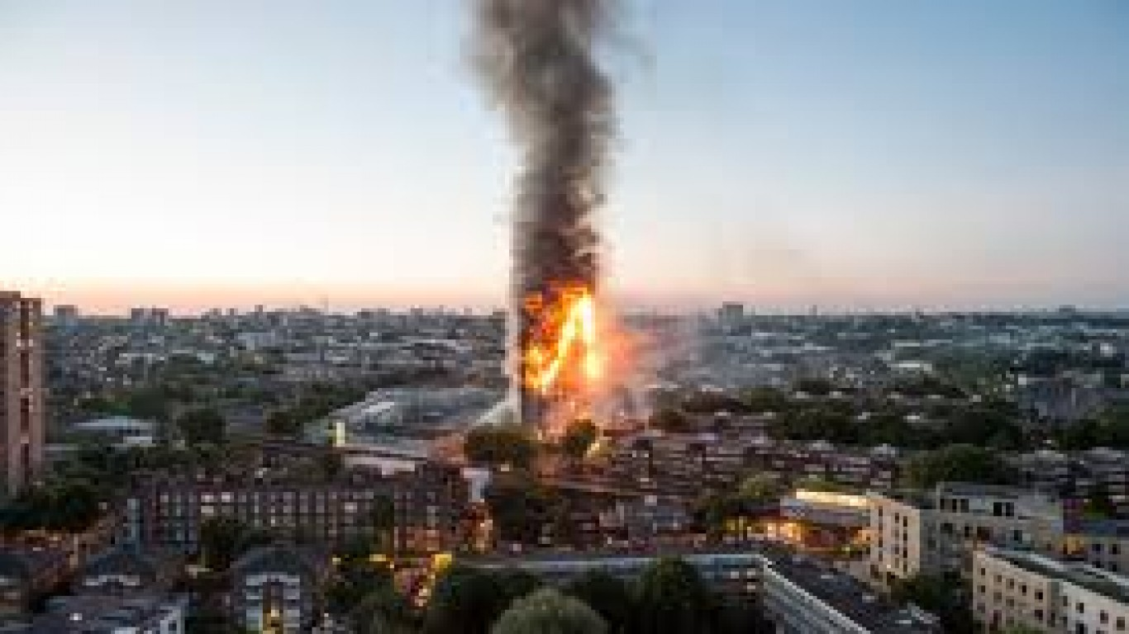
BORN TO FAIL
Are children still experiencing inequality and disadvantage?
Far from improving over time, the situation today appears to be no better than it was nearly five decades ago.
• A child from a disadvantaged background is still far less likely do well in their GCSEs at 16.
• Children living in deprived areas are much more likely to be obese than those living in affluent areas.
• Children from disadvantaged backgrounds are more likely to suffer accidental injuries at home.
• Children living in the most deprived areas are much less likely to have access to green space and places to play.
Overall the inequality that existed 50 years ago still persists today, and in some respects has become worse.
The fact that the poverty and inequality experienced by our children remains just as prevalent today as it did nearly 50 years ago must not be ignored…there is a real risk of sleepwalking into a world where inequality and disadvantage are so deeply entrenched that our children grow up in a state of social apartheid.

Slide 12

Enduring Challenges
‘Despite the improving picture of childhood health, there remains significant inequality in children’s experience of the wider social determinants of health, resulting in long term and enduring health inequalities… health is influenced by the distribution of income, wealth and power within a society which are in turn influenced by the social, economic and political structures…
This means that children living in poverty are most at risk of the negative impact of the wider determinants of health. One in four (260,000) of Scotland’s children are officially recognised as living in poverty – defined as living in a household with less than 60% of median household income’ http://www.healthscotland.scot/population-groups/children

Slide 13
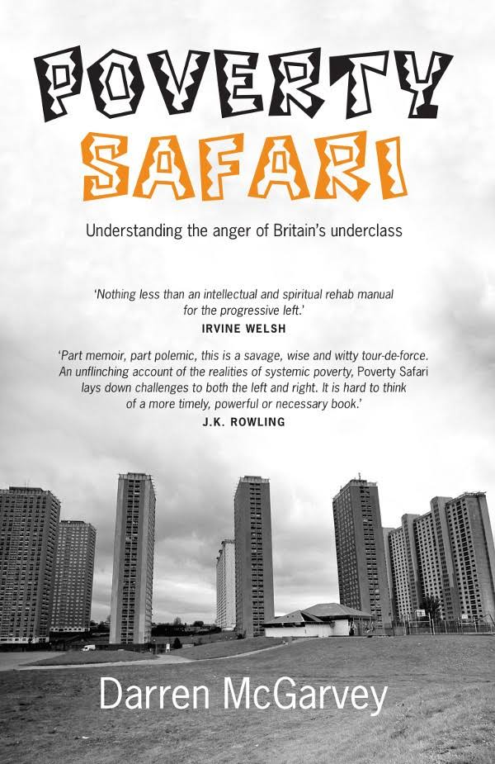
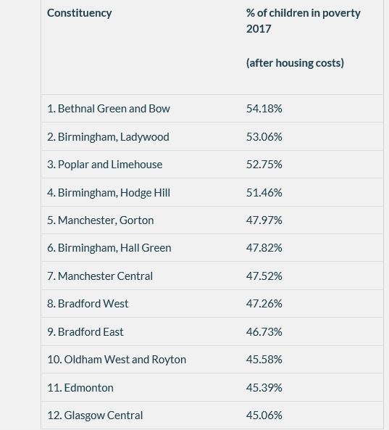
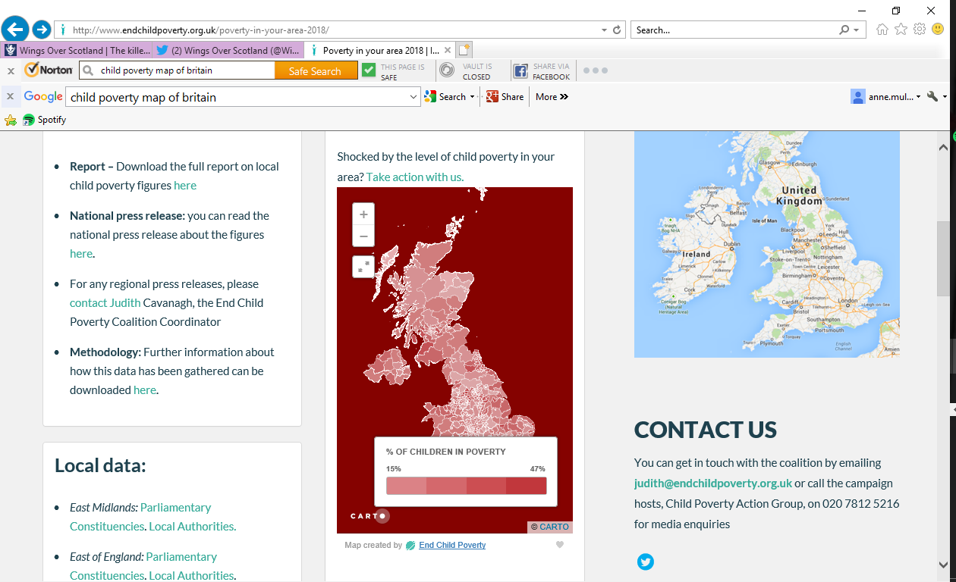
CHILD POVERTY
SAFARI
‘End Child Poverty coalition calls for an end to
the freeze on children's benefits as new figures
released today show that there are some
constituencies in the UK today where more
than half of children are growing up in poverty.
The figures also show that some of the most
deprived areas of the UK have seen the biggest increases in child poverty since the coalition’s
last local child poverty figures for December
2015.The coalition is also concerned that the
impact of poverty may be exacerbated by a
poverty premium… low income families can
face paying as much as £1700 per year
more than better off families, to buy the same
essential goods and services. A major
contributor to this is the high cost of credit for
low income families, and the coalition wants
to see the Government address this by
providing better access to interest free credit’

Slide 14
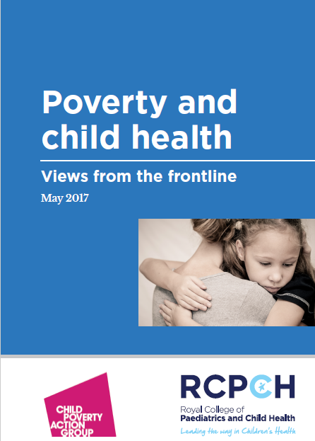
Poverty and children’s health: views from the frontline
Families on lower incomes are not able to provide the opportunities which may directly impact health – for example continuous glucose monitoring devices; healthy food; sports and other activities’
‘Issues that could and should have been managed by routine universal services (such as parenting support) have not been due to service cuts, and therefore we see families when they have reached crisis point.’
‘Financial worries are a huge concern for many of our families and have an impact on parents’ mental health and their ability to cope with challenging circumstances’
‘[We] see parents in A&E who are limiting their eating to care for their children. Children are worried, scared and upset.’
‘Many of our [patients] are from low income families who rely on food banks’
‘I see many disabled children who are living in inadequate housing which causes significant stress to families, back problems through having to lift children, etc.’
‘Single mother evicted from rented property given accommodation in a Travelodge in another town. The child had multiple allergies. Could not afford decent meals.’

Slide 15
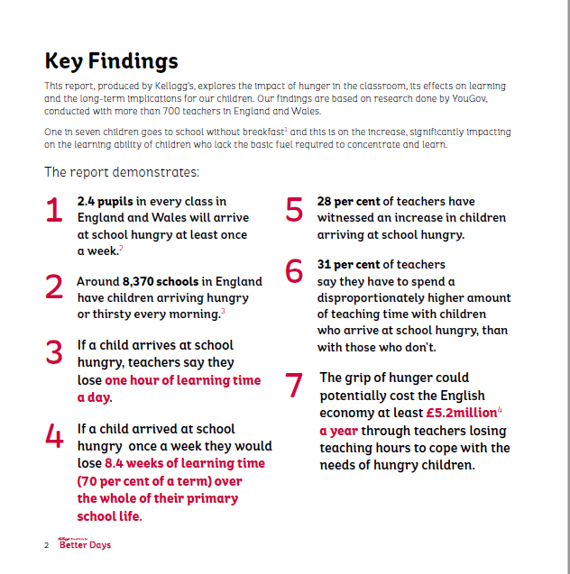
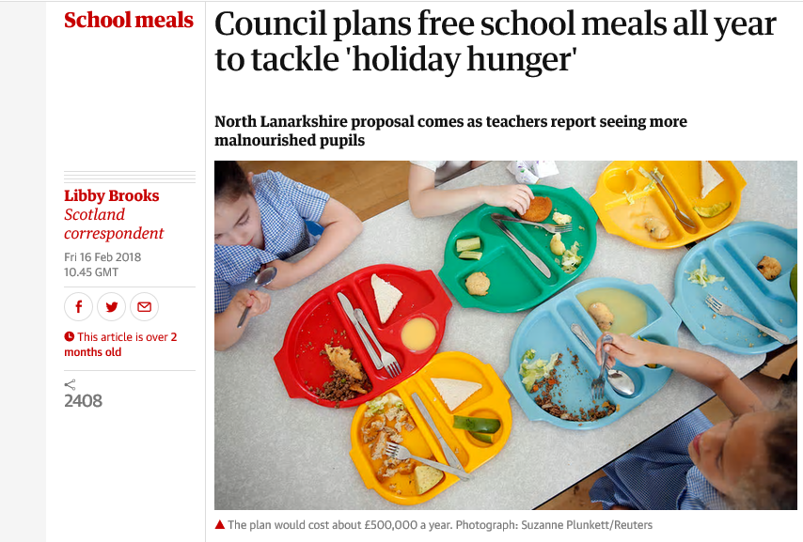

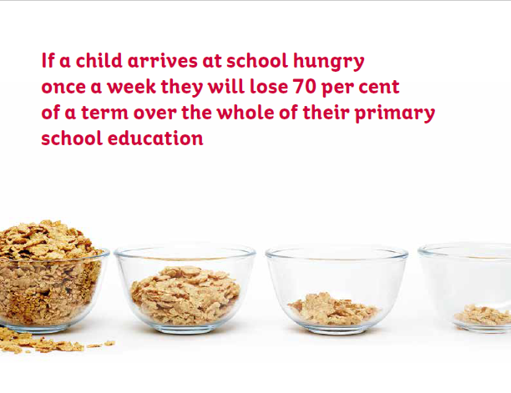
‘I NOTED SUCH CASES OF CHILDREN WITHOUT AN OUNCE OF SUPERFLUOUS FLESH UPON THEM, WITH SKIN HARSH AND ROUGH…I FEAR IT IS FROM THIS CLASS THAT THE RANKS OF PILFERERS AND SNEAK THIEVES COME, AND THEIR CLEVERNESS IS NOT OF ANY REAL INTELLECTUAL VALUE’
DR ARKLE REPORTING TO THE POOR LAW COMMISSION IN 1908
21ST CENTURY SOLUTIONS
VICTORIAN VALUES

Slide 16
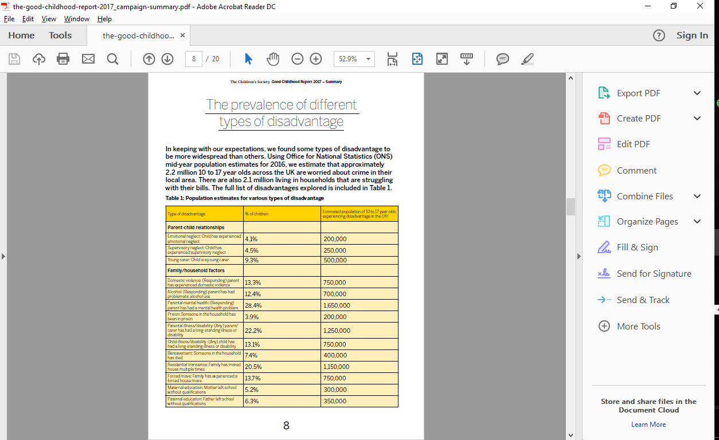
Good Childhood Report 2017
However, there is an increasing gap emerging between the scale of the need and the funding available for local authorities to help children
and families deal with these problems. The Government must urgently review the funding available for local authority children’s services in order to equip them to adequately address the
scale of demand.
https://www.childrenssociety.org.uk/the-good-childhood-report-2017

Slide 17
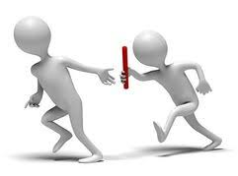
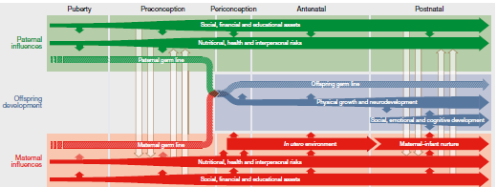
PASS IT ON
HISTORICAL AND GENERATIONAL TRAUMA - EPIGENETIC CONSEQUENCES OF TOXIC STRESS
TOXIC STRESS CAUSED BY ACES CAN ALTER HOW OUR DNA FUNCTIONS.
THAT CAN BE PASSED ON FROM GENERATION TO GENERATION
NOT ONLY ASKING: "WHAT HAPPENED TO YOU?", ALSO ASKING"WHAT HAPPENED TO YOUR
PARENTS?" TO YOUR GRANDPARENTS?
TO YOUR GREAT-GRANDPARENTS? TO YOUR TRIBE, ETHNIC GROUP, ETC.?
Reproduced with the permission of Warren Larkin
CREATING HEALTH-PROMOTING ENVIRONMENTS FOR ADOLESCENTS WILL ULTIMATELY REQUIRE ENGAGEMENT WELL BEYOND THE HEALTH SECTOR, WITH EDUCATION, LOCAL GOVERNMENT, INDUSTRY, RELIGIOUS LEADERS, CIVIL SOCIETY AND YOUNG PEOPLE THEMSELVES ALL ESSENTIAL ACTORS. IN A WORLD OF COMPETING POLICY PRIORITIES, THERE IS NO DOUBT THAT PROVIDING THE RESOURCES FOR HEALTHY ADOLESCENT GROWTH, EDUCATION AND EMOTIONAL DEVELOPMENT WILL YIELD LARGE BENEFITS FOR CURRENT AND FUTURE GENERATIONS.
Adolescence and the next generation doi:10.1038/nature25759

Slide 18
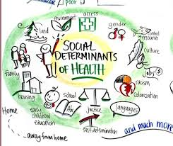
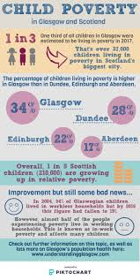
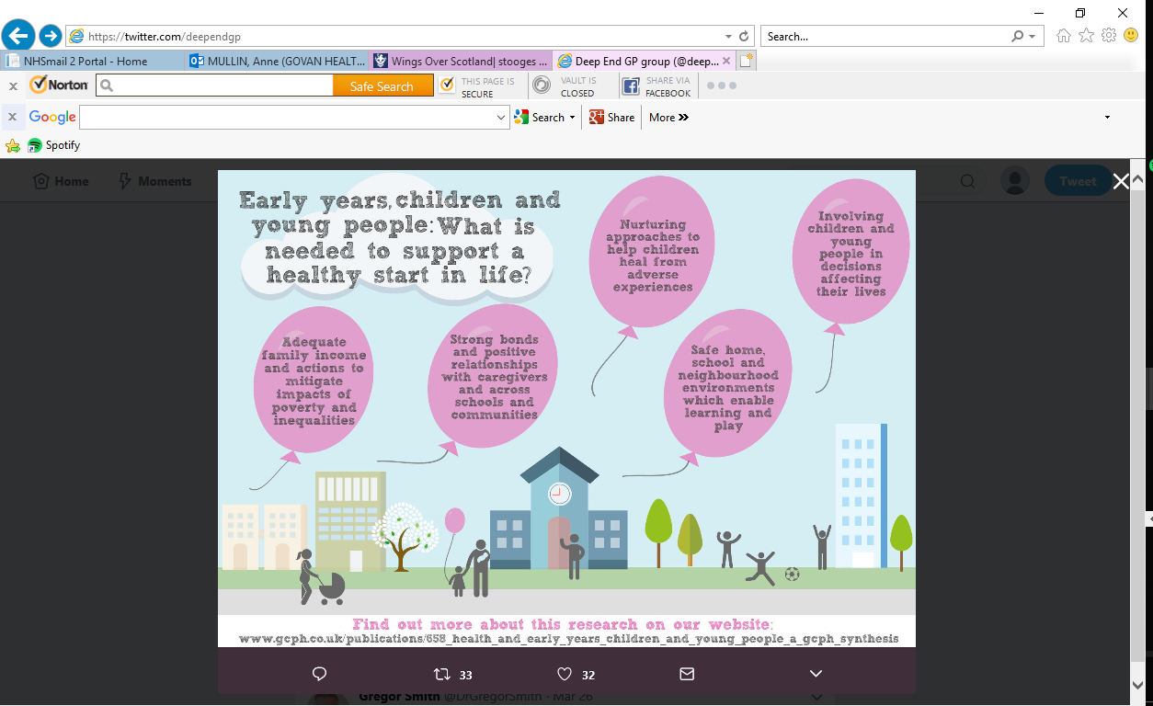
We Know the Answers!

Slide 19

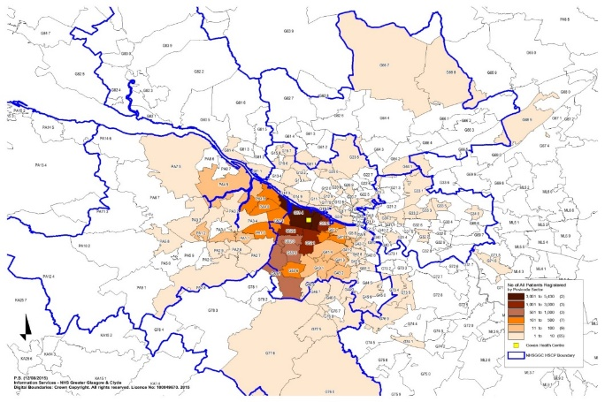
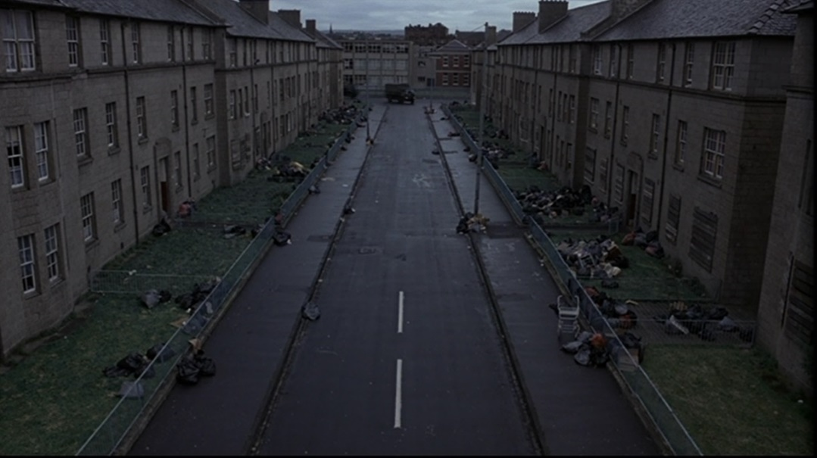
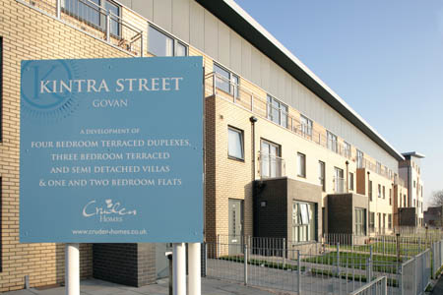
Measure | Govan/ Linthouse | WhiteCraigs
Male Life Expectancy | 67 | 85
Female Life Expectancy | 73 | 94
Patients hospitalised with coronary heart disease | 570 | 35
Early deaths from CHD (<75) | 95 | 35
Patients hospitalised with asthma | 94 | 44
Patients with emergency hospitalisations | 11880 | 5621
Patients (65+) with multiple emergency hospitalisations | 8913 | 3979
Patients with a psychiatric hospitalisation | 630 | 95
Deaths from suicide | 36 | 11
Teenage pregnancies | 81 | 17
Mothers smoking during pregnancy | 32% | 3.4%
Immunisation uptake at 24 months - 5 in 1 | 97.6% | 97.1%
Immunisation uptake at 24 months - MMR | 97% | 93%
Children Living in Poverty http://www.scotpho.org.uk | 38% | 3%

Slide 20
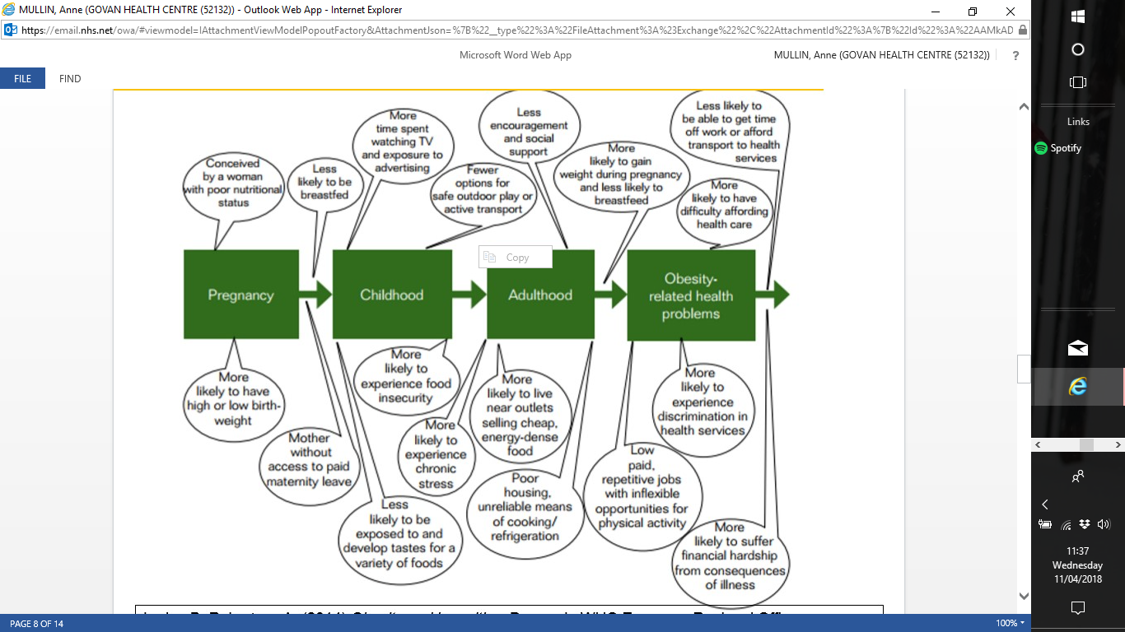
THE GENEALOGY OF THE OBESITY CRISIS
Reproduced with the permission of David Blane

Slide 21
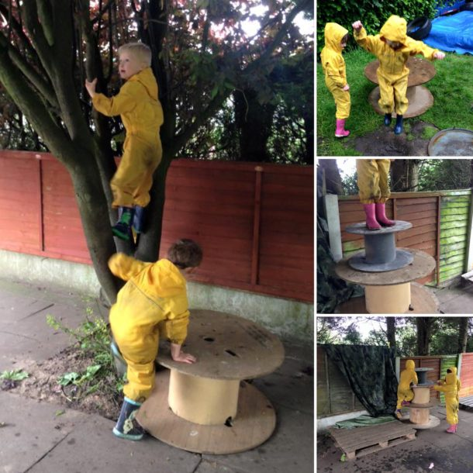

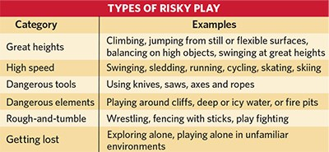
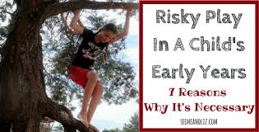
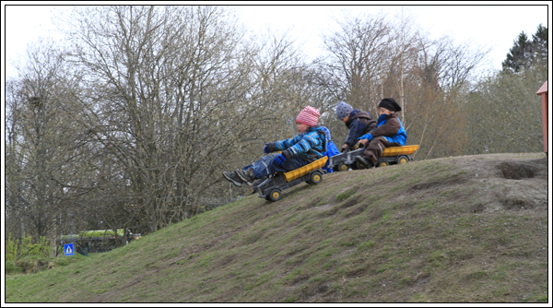
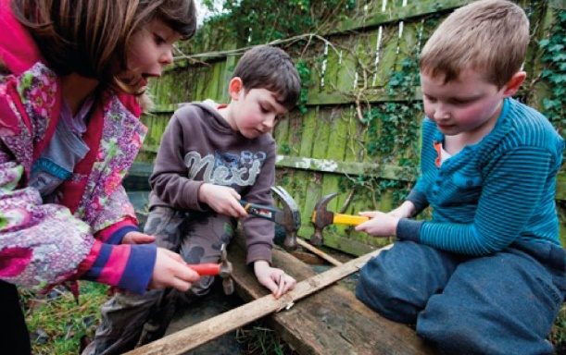
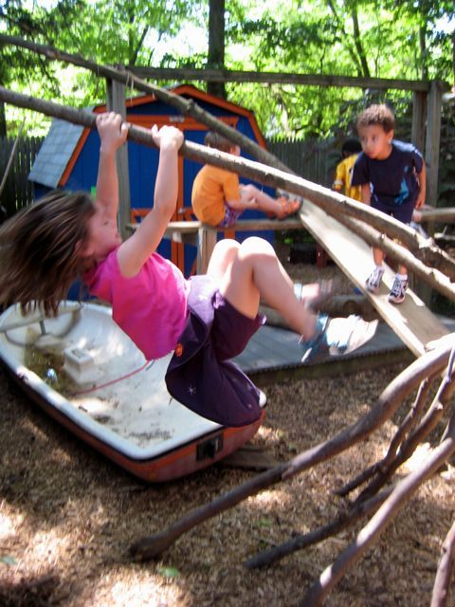
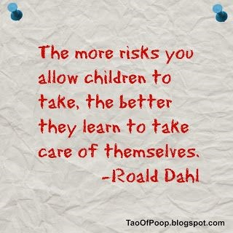

RISKY PLAY – ARE WE READY TO TAKE THAT LEAP?
‘injuries are an inevitable side effect
of physical activity, which is necessary for
a healthy and active lifestyle…children
in an experimental group exposed to a 14-week risky
play intervention improved their risk detection
and competence, increased self-esteem and decreased conflict sensitivity, The vast majority of risky outdoor
play-related injury incidents result in minor injuries
requiring minimal or no medical treatment
Risk minimised by;
Adult Supervision
Playground Safety Standards
Int. J. Environ. Res. Public Health 2015, 12, 6423-6454doi:10.3390/ijerph120606423

Slide 22



Slide 23
12/10/16 (SOUTH CHP) | LOOKED AFTER & ACCOMODATED | LOOKED AFTER IN HOME SETTING | ON CHILD PROTECTION REGISTER
Male | 190 | 277 | 54
Female | 207 | 255 | 50
Total | 397 | 532 | 111 (7 UNBORN) (2723)
AGEBAND
0-4 years | 69 | 57 | 47(INCL. UNBORN)
5-9years | 95 | 151 | 34
10-12 years | 63 | 132 | 15
13-15 years | 89 | 124 | 4
>16 years | 91 | 68 | 1
TYPE OF PLACEMENT |  |  | Dom. Abuse 31 Neglect 29 Emotion. Abuse 24 Phys. Abuse 17 Sex Abuse 15 Parental MH 3 Non-eng. Family 2 Alcohol Issues 2 Drug Problems 2
Foster care | 341
Children’s Unit | 41
Other | 15
With Parents |  | 145
Kinship |  | 387
Scotland’s Population Children & Young People 2016
0-15 yrs 0.92 million ;16-24 yrs 0.61 million

Slide 24

SUPPORTING PARENTS & CHILDREN- WHERE SHOULD WE BE LOOKING ?
WHAT LIES BENEATH
RESISTANT PARENTS - HOSTILITY – WORKERS BACK OFF AVOIDANT PARENTS - DNAS FOR MEDICAL OR SCHOOL APPOINTMENTS CHAOTIC/UNSTABLE PARENT
APPARENT COMPLIANCE - NOT IN FOR HOME VISIT, BUT COME TO OFFICE LATER – DIRT ETC COVERING BRUISES, CHILD NOT SEEN ALONE - COLLUSION BY WORKERS
CHILD NOT SEEN - NON SCHOOL ATTENDER
CORE FAMILIES ON HEALTH VISITOR CASELOADS – NO REGULAR CONTACT
CULTURAL – DIFFERENT VIEWS ABOUT CHILD REARING
TRAFFICKING
ORGANISATIONAL -BIG CASELOADS - POOR RECORDING -INEXPERIENCED WORKERS, LACKING CONFIDENCE -WORKER THRESHOLDS - LINKING TOGETHER INFORMATION E.G. INVOLVING THIRD SECTOR
= INVERSE CARE LAW ( HEALTH)
= INVERSE INTERVENTION LAW , START AGAIN SYNDROME (SOCIAL SERVICES)

Slide 25


NEW
KID
ON
THE
BLOCK

Slide 26


https://youngminds.org.uk/media/2142/ym-addressing-adversity-book-web.pdf

Slide 27

GENERAL PRACTICE BRICOLAGE.
SUPPORTIVE FAMILY PRACTICE –IT’S AN ARTFUL SCIENCE
The essential ingredients for general practice to make a difference.
CONSULTATIONS, CARING, CONTINUITY,
COVERAGE, CAPACITY, COMMUNITY, COORDINATION,
CREATIVITY, COMMITMENT,
COLLEGIALITY, CONSISTENCY AND CAMPAIGNING (Graham Watt)
What Patients Want;
CARING AND COMPASSIONATE STAFF AND SERVICES
CLEAR, EFFECTIVE COMMUNICATION AND EXPLANATION ABOUT CONDITIONS AND TREATMENT
EFFECTIVE COLLABORATION BETWEEN CLINICIANS, PATIENTS AND OTHERS
A CLEAN AND SAFE ENVIRONMENT
CONTINUITY OF CARE
CLINICAL EXCELLENCE.
NHS Healthcare Quality Strategy

Slide 28

It’s Not All About Ticking a Box For Clicky Hips and Heart Murmers!
GPs have a minimal role in child health surveillance in Scotland since 2006 -a single assessment at 6-8 weeks focussed on physical examination.
Coverage of the 10 day review is high (99%), but it progressively declines for reviews at older ages (86% for the 39–42 month review).
Coverage is lower in children living in the most deprived areas for all reviews, and the discrepancy progressively increases for reviews at older ages (78% and 92% coverage for the 39–42 month review in most and least deprived groups).
The inverse care law continues to operate in relation to ‘universal’ child health reviews. Equitable uptake of reviews is important to ensure maximum likely impact on inequalities in children's outcomes
Wood et al http://dx.doi.org/10.1136/bmjopen-2011-000759

Slide 29

KEEP THE BABY IN THE BATHWATER
Prior to the changes to the CHS system, GPs often contributed to CHS reviews at 6–8 weeks and 8–9 and 39–42 months.
Following the changes, GP provision of the 6–8 week review continued but other reviews essentially ceased. Few additional consultations with pre-school children are recorded as involving other aspects of preventive care, and the changes to CHS have had no impact on this.
In the 2½ years before and after the changes, consultations recorded as involving any form of preventive care accounted for 11% and 7.5% respectively of all consultations with children aged 0–4 years, with the decline due to reductions in CHS reviews.
Effective preventive care through the early years can help children secure good health and developmental outcomes. GPs are well placed to contribute to the provision of such care.
Consultations focused on preventive care form a small minority of GPs’ contacts with pre-school children, however, particularly since the reduction in the number of CHS reviews.
Wood and Wilson BMC Family Practice 2012, 13:73 http://www.biomedcentral.com/1471-2296/13/73

Slide 30
WHAT DOES THE ‘TROUBLED FAMILY’ LOOK LIKE?
David is 14 months old. His 18 year old mum Sarah has had anxiety problems since her older brother hanged himself four years ago. She started college but left when she fell pregnant shortly afterwards. Sarah does not get on well with her mother, whom she accuses of drinking and “always shouting” since her brother died. Her mum says she is “mental” and a “teenage brat”. Sarah relies heavily on her own gran Margaret. Aged 50 she has moderately severe COPD (emphysema) and continues to smoke. Margaret has had several chest infections recently and is struggling to cope with Sarah's often strange behaviour and with a lively toddler for whom she is the main caregiver.
For David the next two years, as he learns to walk, talk and interact, will have a huge effect on the rest of his life. Early years interventions such as parenting classes may be important, but on their own will fail to change his life opportunities. He will need supportive neighbours, a good nursery and adequate family income, but also optimal COPD nurse reviews, responsive alcohol and mental health services, good communication with social work, persistent contraceptive advice and smoking cessation support, to name a few. At the hub of these lies the primary care team, offering unconditional care and the possibility of trusted relationships over the span of David’s life ( Deep End Report 23).

Slide 31

Shining a light on what can be learned from new care models to change in the NHS Starling, The Health Foundation)
1. Start by focusing on a specific population.
2. Involve primary care from the start.
3. Go where the energy is.
4. Spend time developing shared understanding of challenges.
5. Work through and thoroughly test assumptions about how activities will achieve results.
6. Find ways to learn from others and assess suitability of interventions.
7. Set up an ‘engine room’ for change.
8. Distribute decision-making roles.
9. Invest in workforce development at all levels.
10. Test, evaluate and adapt for continuous improvement.

Slide 32



GOVAN SHIP Getting Us From H1-H3
Navigating Horizon 2
HORIZON 1 SINKING IN THE DEEP END
PRE-ESTABLISHED TEAM WORKING BUT NO STRATEGIC SUPPORT
COLLECTIVE MEMORY OF WORKING WITH ATTACHED SOCIAL WORKER- A POSITIVE EXPERIENCE. LOSS OF ORGANISATIONAL MEMORY
CLUNKY COMMUNICATION SYSTEMS - AN ONGOING FRUSTRATION
FRAGMENTED DATA SYSTEMS
GP CONTRACT - MINIMISES MATERNITY, PAEDIATRIC AND FAMILY HEALTH CARE
NO SPECIFIC ROLE FOR GPS IN CARE OF VULNERABLE CHILDREN & FAMILIES DESPITE BEING THE ‘HUB’ AND POINT OF CONTACT FOR OTHER SERVICES / OUTSIDE AGENCIES
VULNERABLE ADULTS OFTEN DON’T REACH THRESHOLDS OF SERVICE PROVISION.BOUNDARIES TO SERVICE PROVISION ARE BARRIERS TO ACCESS TO SERVICE
VERY LITTLE RESEARCH TO ARGUE OUR CASE. GPS DON’T WRITE THINGS DOWN, DIFFICULT TO QUANTIFY ‘NON EVENTS’
EXPERIENCE DOESN’T SEEM TO COUNT
HORIZON 3 SAILING ON CALM WATERS
PROTECTED TIME - CASE PLANNING
PROFESSIONAL RELATIONSHIPS - FACE-TO FACE DISCUSSIONS- BLURRING THE BOUNDARIES – ALL WORKING AS GENERALISTS,
INFRASTRUCTURE- E.G. MDT MEETINGS ,JSTs, WHOLE SYSTEMS APPROACH, 1Y & 2Y CARE INTERFACE, STEERING GROUP
MULTIMORBIDITY DATABASE
DOCUMENTATION - MINUTED MEETINGS, DIARIES ADMIN SUPPORT
PATIENT ENGAGEMENT
RESEARCH THAT FITS WORKING PRACTICES (E.G. EVALUATION REPORT)
BIGGER PICTURE - LINKS WORKERS, MENTAL HEALTH, EDUCATION, 3RS SECTOR MANAGEMENT (UNDERSTANDING BUDGETARY CONSTRAINTS AND PLANNING NETWORKS)
NORMALISING THE PROJECT WORK THROUGH CONNECTIVITY, EMBEDDED KNOWLEDGE, KNOWLEDGE EXCHANGE – AN ECOLOGY OF LEARNING
Notes:
Relevant others- CMHT DME

Slide 33
Putting It All Together – SHIP MDT
Workstreams
Children & Families
Frail & Elderly
Unscheduled Care
Information Management
Other
Social Care Worker
Mental Health
As Required
2y care
Education
Housing
Carer Support
Welfare
Well being
Social isolation
District Nurse
FOCUS
Patient / Client
Child/Parent/Family
unit
Health Visitor
Rehabilitation/
Physiotherapist
Links Worker
General Practitioner (GP)

Slide 34


Won’t Somebody Please Think of the Children?
Case 1 ’Extended surgery consultation with school age child and mother due to behavioural problems at school stemming from Autistic Spectrum Disorder. Outcome: discussed support structures available through health, education and third sectors. Information regarding diagnosis and impact on family discussed at length. Management strategies discussed and agreed for both individuals with goal setting, etc.’
Case 2 ‘Child < 5 years frequent attender to surgery with minor self-limiting symptoms. English poor and requires translator. Planned review to discuss support and education of such illness; Outcome: linked in with Health Visitor for further ongoing support which also involves local third sector agencies. Aim to support mother and reduce attendances at general practice.’

Slide 35

That Jigsaw Thing
EVERY CHILD , EVERY CHANCE
GIRFEC
EARLY YEARS FRAMEWORK
REFRESHED FRAMEWORK FOR MATERNITY
CARE SCOTLAND
NATIONAL PARENTING STRATEGY
EARLY YEARS COLLABORATIVE +
RAISING ATTAINEMENT FOR ALL=CYPIC
BOOK BUG
BABY BOXES
NAMED PERSON
EARLY LEARNING AND CHILDCARE
CHILDREN AND YOUNG PEOPLE
(SCOTLAND) ACT 2014
THE WELLBEING OF PEOPLE AND COMMUNITIES IS CORE TO THE AIMS AND SUCCESS OF COMMUNITY
A STRONG AND THRIVING GENERAL PRACTICE IS CRITICAL TO SUSTAINING HIGH QUALITY UNIVERSAL HEALTHCARE AND REALISING SCOTLAND’S AMBITION TO IMPROVE OUR POPULATION’S HEALTH AND REDUCE HEALTH INEQUALITIES.
EQUALITIES AND SOCIO ECONOMIC IMPACTS ARE UNDER CONSIDERATION
GPS WILL BE MORE INVOLVED IN INFLUENCING THE WIDER SYSTEM TO IMPROVE LOCAL POPULATION HEALTH IN THEIR COMMUNITIES (Primary Care Improvement Plan)

Slide 36


REPORT 3 The GP Role In Working With Vulnerable Families (Jan 2010)
REPORT 6 Patient Encounters In Very Deprived Areas: What Can Be Achieved? (May 2010)
REPORT 8 Social Prescribing (Sep 2010)
REPORT 12 Working Together For Vulnerable Children And Families (Sep 2010)
REPORT 18 Integrated Care (Jul 2012)
REPORT 20 What Can NHS Scotland Do To Prevent/Reduce Health Inequalities? (Apr 2013)
REPORT 23 The Contribution Of General Practice To Improving The Health Of Vulnerable Children And Families (Jun 2014)
REPORT 25 Strengthening Primary Care Partnership Responses To The Welfare Reforms (Nov 2014)
REPORT 26 Generalist And Specialist Views Of Mental Health Issues In Very Deprived Areas (Dec 2014)
REPORT 29 GP Use Of Additional Time As Part Of The SHIP Project (June 2016)
WORDS AND DEEDS
Safeguarding in general practice has the potential to
use core ‘family doctor’ skills to meet the health needs
(in the widest sense of the term) …young people,
and their families and doing so in tandem with
statutory child protection responses…Models of
care that promote continuity of care and a holistic approach are likely to facilitate effective
GP responses to these children and their families. https://www.ncbi.nlm.nih.gov/pmc/articles/PMC4141592/

Slide 37
THANKYOU! ANY QUESTIONS?

