Slide 1



Tackling child poverty
Mark Willis
26 April 2018
Notes:
Workshop 5: Child poverty
Kathryn Chisholm, Scottish Government
Mark Willis, CPAG Scotland
One in four children live in poverty in Scotland with this number predicted to rise. This workshop will look at the Child Poverty (Scotland) Act and how it will be delivered
nationally and locally.
• The Scottish Government recently launched its first Child Poverty Delivery Plan. Learn more about the contents of the Plan and discuss how it can be delivered in local areas.
• CPAG will highlight good practice examples of initiatives that can be built into local child poverty action delivery plans.

Slide 2
National Child Poverty Targets
Interim Targets – 2023
Final Targets - 2030/31
< 18% of children in relative poverty
< 14% of children in absolute poverty
< 8% of children in low income and material deprivation
< 8% of children in persistent poverty
< 10% of children in relative poverty.
< 5% of children in absolute poverty.
< 5% in combined low income/material deprivation.
< 5% in households in persistent poverty.
Notes:
Child Poverty (Scotland) Act 2017 places a duty on Scottish Govt to eradicate CP by 2030/31 – after housing costs
Relative poverty
A child falls within this section in a financial year if the child lives in a household whose equivalised net income for the year is less than 60% of median equivalised net household income for the year.
Absolute poverty
(1) A child falls within this section in a financial year if the child lives in a household whose equivalised net income for the year is less than 60% of the amount of median equivalised net household income for the financial year beginning with 1 April 2010, adjusted to take account of changes in the value of money since that financial year.
Combined low income and material deprivation
A child falls within this section in a financial year if the child—
(a) lives in a household whose equivalised net income for the year is less than 70% of median equivalised net household income for the year, and
(b) experiences material deprivation in the year.
Persistent poverty
(1) A child falls within this section in a financial year if the child has lived—
(a) in each of the survey years, in a household in Scotland, and
(b) in at least 3 of the survey years, in a household whose equivalised net income for the survey year was less than 60% of median equivalised net household income for the survey year.
(2) The survey years are—
(a) the calendar year that ends during the financial year, and
(b) the 3 previous calendar years.

Slide 3
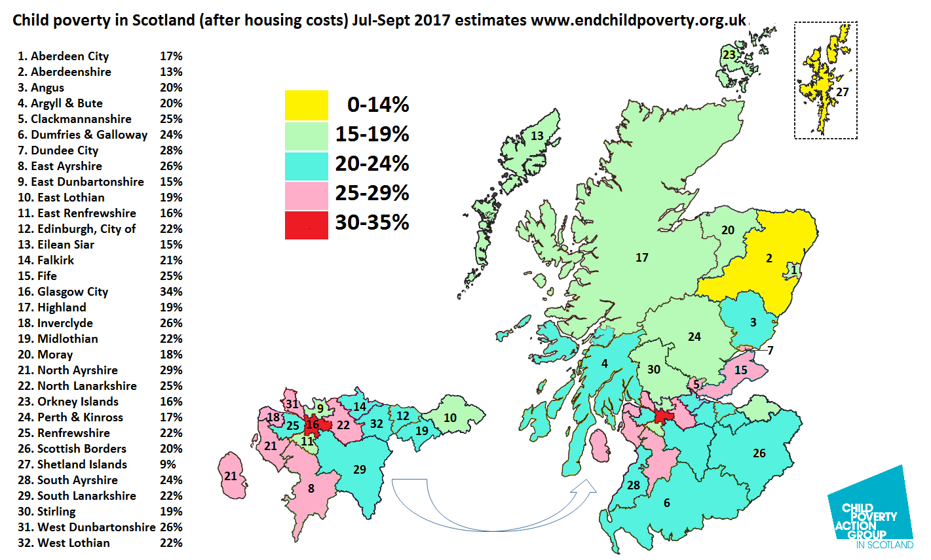
Notes:
Relative – uses HMRC data re tax credits
NB targets are national not local

Slide 4
Challenging Landscape
Almost 1 in 4 children living in poverty
– 66% of those in working households.
By 2020/21 post-2015 ‘welfare reforms’ will take another £1bn out of household incomes in Scotland alone, on top of £1.1 billion already lost since 2010.
Households with children worst affected.
Key cuts include benefits freeze, benefit cap, two child limit.
Notes:
Nothing inevitable about levels of poverty
Over two thirds children in poverty (66%) in working households. 2014-17
Affects families in every part of Scotland
Rising levels of acute income crisis.
Impact on health, education wellbeing
NOT inevitable.
Real progress: by 2011/12 170 000 fewer children in poverty than in 1996/7
Policy worked – at UK and Scottish level
NMW, childcare, child benefit and tax credits, employment support and rights
Child wellbeing improved
Child poverty is not inevitable
Cost of inaction –2013 report - £29bn cost
Targets welcome but must be back by real actions and *funded*.
In 2013, Child Poverty Action Group published estimates that put the costs of UK child poverty at £29 billion per year, but that this could rise to £35 billion a year if child poverty rises to 3.4 million (before housing costs) by 2020 – the latest estimates suggest it will rise higher than this. These include:
Spending on services to deal with the consequences of child poverty (£15 billion)
Tax receipts lost to government as a result of people earning less, having grown up in poverty (£3.5 billion)
Benefits spent on people who are out of work more as a result of growing up in poverty (£2.4 billion)
Loss in private post-tax earnings by adults who have grown up in poverty (£8.5 billion)
See http://www.cpag.org.uk/content/estimate-cost-child-poverty-2013

Slide 5
Child Poverty (Scotland) Act - Delivery Plan
Income supplement for low income families
Financial Health Check Guarantee
Cost of the School Day
Food and fuel poverty
Childcare Expansion
Action on Work and Earnings
Notes:
SG published first Tackling Child Poverty Delivery Plan under the CP (Scotland) 2017 Act just before Easter.
Headline announcements
SG committed to introducing a new income supplement for low income families. Use of new powers allow SG to top up or introduce new benefits. Give Me Five campaign calling SG to use these powers to top up CB by £5 a week.
Also new using new powers to replace SSMG with the more Best Start Grant and to introduce a Young Carer Grant for 16-17 year olds
Health Check – investing £3m in personalised advice to help with poverty premium and improve benefit take up and £5K to roll out Healthier Wealthier Children Approach
COSD – funding for CPAG’s COSD manager and commitment to establishing minimum school clothing grant
Food and fuel poverty - £1million to tackle food insecurity during school holidays, and boosting uptake of Warmer Homes Scotland Programme – av. Saving of £350 a yr on fuel bills
Childcare expansion – EY and after school and holiday childcare.
Action on Work and Earnings – support parents into employment, support employer led projects that advance equality at work focus on parenthood progression and focus on families at high risk of poverty, marked intention to build a Living Wage Nation, focus on sectors where low pay, esp for women, is a concern eg. tourism and hospitality
We welcome all of these measures – swift progress needed, especially on income supplement, to avert a child poverty crisis where 2/5 children are in poverty by 2030

Slide 6
Local Child Poverty Action Reports
Reports must set out action local authorities and NHS Boards have taken, and will take, jointly with partners:
  to contribute to meeting the child poverty reduction targets set out in the Act
  help support families with income maximisation advice

Slide 7
Local Child Poverty Action Reports:
Next steps
March 2018
June 2018
2018
April 2019
Ongoing
Scottish Government Child Poverty Delivery Plan
Local Action Plans guidance to be published
NHS Health Scotland collating good practice examples from local partners
First Local Child Poverty Action Reports due – Scrutiny by P & I Commission
Best Practice summits to facilitate sharing of good practice
Notes:
Delivery plan published
Draft Local Action Plans guidance out for comments just now, due to be published June
NHS Health Scotland to undertake exercise to collate good practice examples from local partners in early 2018
Will also be annual Best Practice summits convened by Scottish Government, to facilitate the sharing of good practice around what works to tackle child poverty – also scope to share what didn’t work so well!
First plans due April 2019 – to be scrutinized by Poverty and Inequality Commission

Slide 8
What can be done locally?
Advice and information
Reduce essential family outgoings
Make it everyone’s job
Poverty proof services
Notes:
Access to information and advice – both targeted and universal
Income maximisation e.g. Healthier, Wealthier Children
Reduce families outgoings e.g. affordable access to support services (childcare, transport)
Access to emergency support (hardship payments, Scottish Welfare Fund)
Remove financial barriers to public services (e.g. Cost of a School Day recommendations)
Maximise passported entitlements e.g. Free School Meals eligibility & School clothing grants
All frontline local authority and health board staff should have a basic awareness about poverty and welfare reform
Referral pathway to local income maximisation service
Access financial help in emergencies: Scottish Welfare Fund
Healthier Wealthier Children NHS Greater Glasgow & Clyde

Slide 9











Working with whole school communities to reduce financial pressures
for families on low incomes and ensure equal access to opportunities for children and young people
Range of resources available free to download for schools and Parent Councils to support action on Cost of the School Day.
New Cost of the School Day toolkit coming in May. www.cpag.org.uk/cost-school-day
costoftheschoolday@cpagscotland.org.uk
Action planning at school and local authority levels
Notes:
We know that there are a whole range of school costs which, combined, are difficult/impossible for families to afford
Significant costs - uniform, travel, meals and often expensive school trips
Frequent costs - stationery, materials for craft projects and costs for secondary school subjects like Home Ec and Art and Design
Smaller occasional costs - clubs and fun events like discos or fundraising
We know that difficulties with these costs affect children’s experiences at school – what they can do, what they can participate in and how they learn
CSD works with whole school communities to reduce financial pressures school costs place on families and to make sure that all cyp have access to everything that school has to offer with nobody missing out because they can’t afford to pay.
Running for 4 years. CPAG led projects started in Glasgow, now working across Dundee, providing advice and training to local authorities and schools and advocating for this kind of approach to reducing school costs across Scotland.
Next month we’re launching a CoSD toolkit full of resources for schools and Parent Councils.
Just got funding for SG to develop some work around gathering and sharing good practice from all of the schools across Scotland who are working hard to make sure that school costs don’t get in the way of children making the most of school
Key questions we ask children, parents, staff are really simple but can lead to really tangible changes that can make a difference – as on slide
The answers to all of these questions from the perspective of different members of school community then inform action planning both at school level and at local authority level

Slide 10
Further information
Austerity Generation: the impact of a decade of cuts on family incomes and child poverty
Parents’ Voices Report
Local Child Poverty Action Reports - CPAG Scotland Seminar Outcomes (31 October 2017)
Impact of Benefit Cap and DHPs report
Mark Willis – mwillis@cpagscotland.org.uk
Notes:
Austerity Generation: the impact of a decade of cuts on family incomes and child poverty
http://cpag.org.uk/content/austerity-generation-impact-decade-cuts-family-incomes-and-child-poverty
Parents’ Voices Report
http://www.cpag.org.uk/content/challenges-poverty-parents-voices
Local Child Poverty Action Reports - CPAG Scotland Seminar Outcomes http://www.cpag.org.uk/sites/default/files/FINAL%20Seminar%20Report%20%20Local%20Child%20Poverty%20Action%20Reports.pdf
Impact of Benefit Cap and DHPs report http://www.cpag.org.uk/sites/default/files/uploads/CPAG%20-%20Scot%20-%20Benefit%20cap%20report%20%28Jan%2018%29.pdf
Recommendations from the report:
Tackle in work poverty
Increase uptake of benefits
Improve access to the Scottish Welfare Fund
Provide affordable, flexible childcare
Remove financial barriers to education
Ensure the adequacy of social security benefits

Slide 11
Discussion
What else is needed to help deliver change at a local level?
What will be the main challenges in your role?
What support will you need in addition to the guidance?
Notes:
Service provision? Is it universal or targeted?
Delivery of new free childcare commitment?
Automatic passporting of benefits?
How to involve parents? Community engagement?
Poverty training for frontline staff?
How to involve other CPPs?
How to ensure people’s experiences are reflected? E.g. poverty truth commissions?
Do you need to work with other areas within your organisations? Linkages with other reporting duties
Socio-Economic Duty
Children & Young people (Scotland) Act
Community Empowerment (Scotland) Act
Education (Scotland) Act 2015

