Slide 2
Social Inequalities and the Care System: evidence from a UK wide comparative study
Brid Featherstone, University of Huddersfield

Slide 3
The Child Welfare Inequalities Project www.coventry.ac.uk/cwip
Aim: to detail and begin to understand inequalities in the child welfare system, in particular children who are looked after or on child protection registers or plans.

Slide 4
The Child Welfare Inequalities Project
Focus on inequalities in who becomes a looked after child not what happens to children once looked after.
Not a test of ‘what works’ for children in care or to prevent children entering care.

Slide 5
The Child Welfare Inequalities Project
Very large study: basic data on 24,000 Looked After Children and 12,000 children on child protection registers or plans across the 4 UK countries in 2015.
10 Scottish LAs covering more than half all children in Scotland under 18.
Case studies of decision making and practice in 4 English and 2 Scottish LAs.

Slide 6
An Inequalities Perspective on Children’s Social Work Services
Definition: inequity occurs when children and/or their parents face unequal chances, experiences or outcomes of involvement with child welfare services that are systematically associated with structural social disadvantage and are unjust and avoidable.

Slide 7
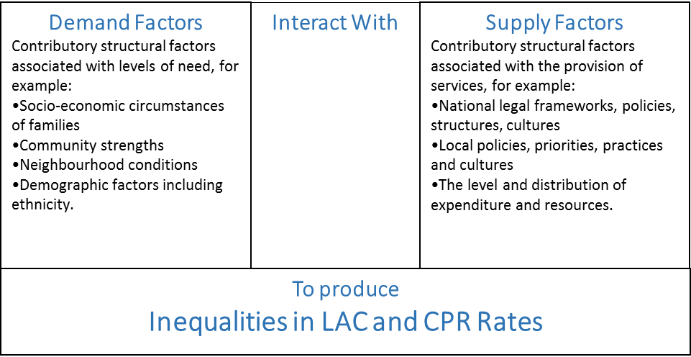
An Inequalities Perspective: factors affecting LAC rates

Slide 8
CWIP Key Findings

Slide 9
CWIP Findings: comparing like with like
Percentage of LAC in each UK country placed with parents, relatives or friends.
 | With a parent | With a relative or friend | With parent, relative or friend
NI | 16 | 31 | 47
England | 5 | 11 | 16
Wales | 11 | 16 | 27
Scotland | 23 | 29 | 52

Slide 10
Scottish LAC rates not with parents, relatives or friends: the highest in the UK

Slide 11
CWIP Key Findings: LAC Rates Glasgow and Belfast

Slide 12
Key Findings: LAC Rates (not at home with relatives or friends) Scotland and NI

Slide 13
Scotland/Northern Ireland comparison
If Scotland LAs had had Northern Irish looked after children rates, after controlling for deprivation, there would have been around 1500 LAC in our 10 LAs rather than the 4000 that there were.

Slide 15
Emerging Findings: Poverty as a Context
Poor localities are the usual sites of social work practice – this is an accepted norm
Poverty is endemic but usually not visible in practice responses and, though there were differences, this was surprisingly consistent across all the sites
When prompted social workers articulate their understanding of the circular relationship between poverty and harms but this understanding was rarely evident in case planning

Slide 16
Practice and Poverty
Social workers don’t see anti poverty activity as ‘core business’ – they say they focus on risk / parenting and that others should be addressing issues of deprivation (food, warmth, shelter)
Poverty: ‘too big to tackle’ in a context of ever diminishing resources
The availability of services shape and constrain social work analysis
A moral muddle? In their attempts to practice equitably, some social workers consciously disengaged with the social context of families lives
Some systems and practices can reinforce the shame and suffering of poverty for family members

Slide 17
Key questions
Is there a need to collect data on parents’ and their circumstances?
Are too many children in Scotland being looked after?
Is there the right balance between care and child protection registration?
Why are rates in low deprivation LAs higher than in high deprivation LAs, when you compare similar neighbourhoods?
Do policy and practice play appropriate attention to families’ socio-economic circumstances?
Should reducing inequalities in child welfare be a central goal of policy, as it is for health and education?

Slide 18
Contact details
P.Bywaters@hud.ac.uk
b.m.featherstone@hud.ac.uk

